Slide 1


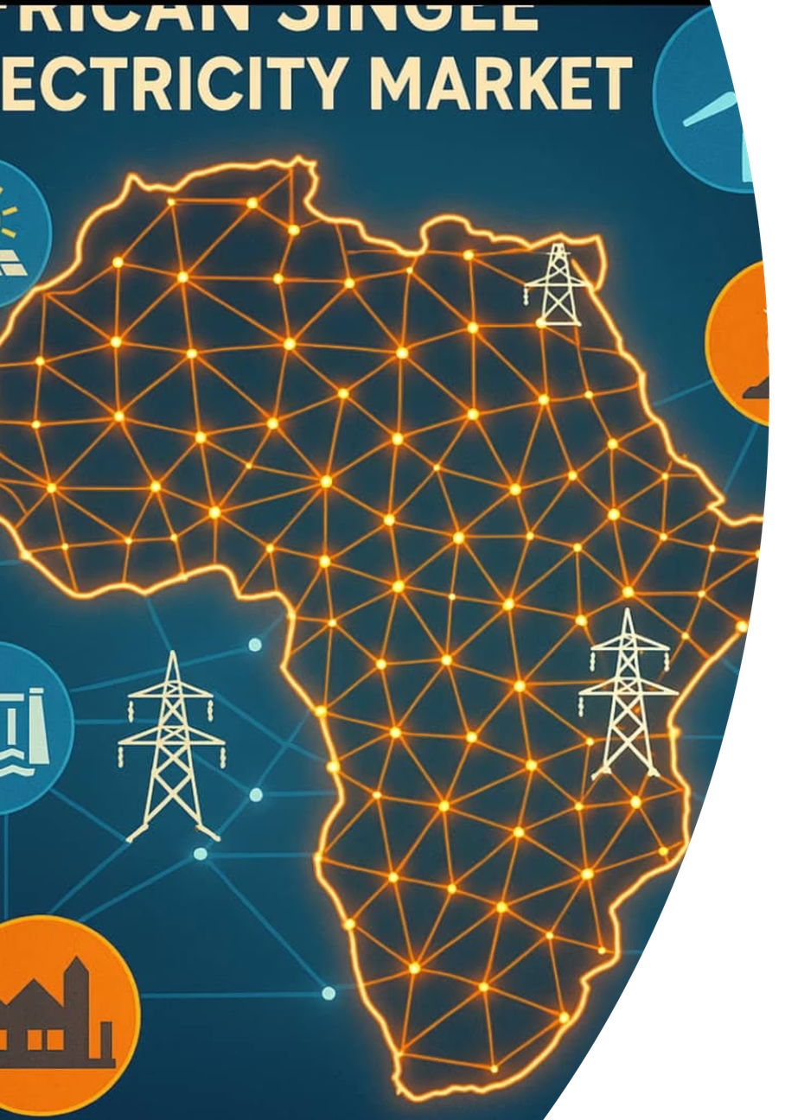
AFRICAN SINGLE ELECTRICITY MARKET (AFSEM)
AUC-ESMAP GLOBAL WEBINAR
The African Power Pools: Building Towards the African Single Electricity Market
11ᵗʰ March 2026
African Union Commission | Department of Infrastructure and Energy

Slide 2

AFSEM BACKGROUND
The African Single Electricity Market is the result of decades of continental commitment to energy integration supported by the EU. Its origins trace back to foundational decisions made at the highest levels of African governance.
2010
CEMA Decision — Call to strengthen and harmonize legal and regulatory frameworks across the African energy sector.
2015
AU–EU Cooperation — Launch of the initial programme on the Harmonisation of Regulatory Frameworks for Electricity Markets in Africa.
2020–2023
AfSEM Adopted — AfSEM recognized as an attribute of WAPP and integrated into continental energy planning frameworks.
2024
Action Plan Approved — The 44th Executive Council of the AU adopted the AfSEM Action Plan and approved AfSEM as a Flagship Project of AU Agenda 2063.

Slide 3





AFSEM ROADMAP: THREE STRATEGIC PHASES
The AfSEM implementation roadmap spans 15 years across three distinct phases, each building the institutional, regulatory, and market foundations needed for a fully integrated continental electricity market by 2040.
SHORT-TERM (2025–2028)
Governance Establishment and Regional Regulatory and Institutional Strengthening — building the coordination and oversight structures for AfSEM.
MEDIUM-TERM (2029–2033)
Legal & Regulatory Alignment — regional-continental harmonization of legal frameworks and the opening of regional power markets to cross-border trading.
LONG-TERM (2034–2040)
Full Market Integration — operationalization of a unified continental electricity market enabling inter-regional electricity trading at scale.

Slide 4
SHORT-TERM IMPLEMENTATION PLAN (2025–2028): KEY SEGMENTS
The Short-Term AfSEM Implementation Plan is organized into four operational segments, each addressing a distinct pillar of market development and institutional readiness.
SEGMENT 1: GOVERNANCE COORDINATION
SEGMENT 2: REGULATORY & INSTITUTIONAL STRENGTHENING
Operationalize the SPCU; constitute the AfSEM Forum and Oversight Committee; create Technical Working Groups; ensure coordination, administration, and monitoring across all AfSEM activities.
Support power pools (EAPP, SAPP, CAPP, COMELEC) to establish functional regional regulatory agencies; develop and implement regulatory instruments for regional power trading; support Member States to build independent national regulators. Adopt the AfDB Electricity Regulatory Index (ERI) for AfSEM monitoring and evaluation.
SEGMENT 3: REGIONAL POWER MARKET DEVELOPMENT
SEGMENT 4: OFF-GRID & RENEWABLE ENERGY MARKETS
Strengthen capacity of SAPP, EAPP, CAPP, WAPP, and COMELEC to harmonize market rules and tariffs; establish Market Trading Platforms; operationalize regional power markets for cross-border electricity trading.
Work with REERECE to harmonize off-grid and mini-grid market policies; develop a competitive RE technology market framework; implement Renewable Energy Markets for African island states; collaborate with AfCFTA on a continental strategy for renewable technology trading.

Slide 5
SEGMENT 1: AFSEM COORDINATION AND GOVERNANCE ESTABLISHMENT
Building the foundational governance architecture to coordinate, monitor, and drive the implementation of the African Single Electricity Market across all institutional levels.

Slide 6




ESTABLISHMENT OF AFSEM GOVERNANCE ORGANS
The AfSEM governance framework establishes four core functional organs, each playing a distinct and essential role in the successful implementation and oversight of the continental electricity market initiative.
AFSEM IMPLEMENTATION MONITORING
AFSEM IMPLEMENTATION CONSULTATION
Continuous tracking of milestones, deliverables, and outcomes across all phases of the AfSEM Action Plan to ensure accountability and timely course correction.
Structured engagement with Member States, RECs, Power Pools, development partners, and other stakeholders to ensure inclusive and informed decision-making.
AFSEM IMPLEMENTATION REPORTING
AFSEM IMPLEMENTATION COORDINATION
Systematic documentation and reporting of progress, challenges, and results to AU governance bodies and development partners to maintain transparency and trust.
Centralized coordination through the Special Projects Coordination Unit (SPCU) to align activities, resources, and timelines across all AfSEM implementing entities.

Slide 7
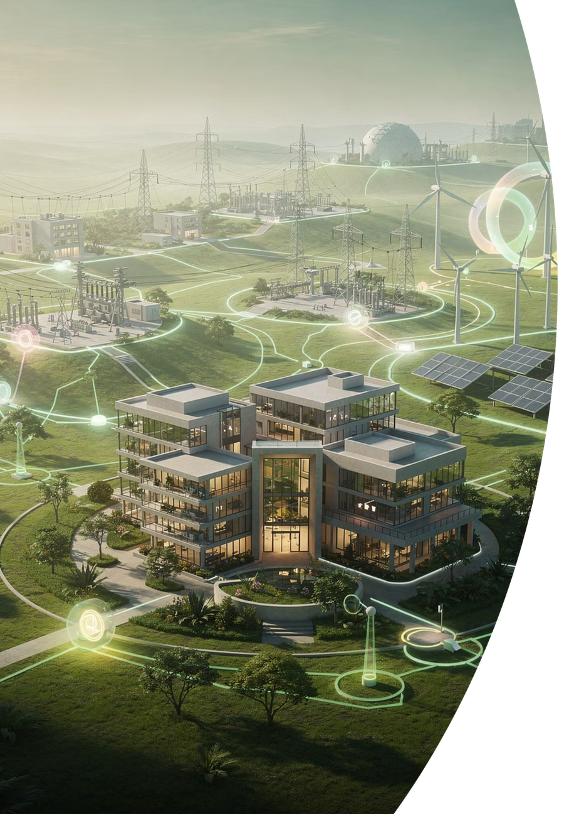
MILESTONE: INSTITUTIONAL COORDINATION AND GOVERNANCE
AfSEM has moved swiftly to establish the institutional backbone required for continental energy market integration. Three landmark coordination milestones have been achieved:
SPCU ESTABLISHED
HTOC INAUGURATED
The Single Project Coordination Unit (SPCU) is now operational supported by BMZ, providing centralized oversight and day-to-day management of AfSEM implementation across all regions.
The High-Level Technical Oversight Committee (HTOC) has been formally inaugurated, providing strategic direction and ensuring accountability at the highest technical and policy levels.
AFSEM FORUM: 1ST & 2ND EDITIONS
The 1st AfSEM Forum was convened in Sharm El-Sheikh (2024) and the 2nd in Cairo (2025), establishing a recurring platform for stakeholder alignment, policy dialogue, and progress review.

Slide 8
SEGMENT 2: REGIONAL REGULATORY AND INSTITUTIONAL STRENGTHENING
Establishing the regulatory backbone and institutional architecture needed to enable a rules-based, harmonized, and functional African electricity market.

Slide 9

REGIONAL REGULATORY & INSTITUTIONAL STRENGTHENING
AfSEM will work systematically with all regional power pools and their member countries to build the regulatory institutions and instruments required for a unified continental electricity market.
DEVELOPMENT OF REGIONAL REGULATORY INSTRUMENTS
REGIONAL POWER POOL COVERAGE
Establish functional regional and national regulatory authorities
Develop and implement regional Market Rules and Grid Codes
Harmonize cross-border transaction documents
Develop harmonized transmission tariff methodology
Build regulatory capacity for current and future market stages
Develop Trading Platforms for futures, forwards, Day-Ahead, and intra-day markets
Develop and adopt Market Surveillance Rules
Develop Ancillary Services Market and pricing methodology
WAPP / ERERA / ECOWAS: Support 14 West African member countries to finalize and establish independent national regulators.
SAPP / EAPP / IRB / RERA: Work with Southern and Eastern African member countries to activate and operationalize independent national regulators.
CAPP / COMELEC: Support Central African and island state member countries to establish independent national regulatory bodies.
ADOPTION OF AFDB ERI
The AfDB Electricity Regulatory Index (ERI) will be adopted as the standard benchmarking tool for monitoring national regulatory progress toward AfSEM readiness.
Partners: EU · BMZ · AfDB · World Bank

Slide 10

MILESTONE: REGIONAL REGULATORY STRENGTHENING
AfSEM is actively reinforcing regulatory institutions in both Southern and Eastern Africa — enhancing independence, governance, and investment readiness at the regional level.
SOUTHERN AFRICA
EASTERN AFRICA
RERA → SARERA TRANSITION
INDEPENDENT REGULATORY BOARD (IRB)
In Eastern Africa, AfSEM is bolstering the Independent Regulatory Board (IRB) by reinforcing coordination capacity, improving investment readiness, and evaluating its 3-year action plan.
This includes developing Power Purchase Agreements (PPAs) for hydro, wind, and solar energy projects to accelerate bankable cross-border transactions.
AfSEM support is enabling the transformation of RERA into the Southern African Regional Energy Regulator (SARERA) — a critical step in consolidating regulatory authority, ensuring independence, and strengthening regional market governance across Southern Africa.

Slide 11
SEGMENT 3: REGIONAL POWER MARKETS DEVELOPMENT AND OPERATION
Operationalizing Africa's regional power markets — developing the trading platforms, harmonized rules, and infrastructure needed for functional cross-border and inter-regional electricity trading under AfSEM.

Slide 12
OPERATIONALIZATION OF REGIONAL POWER MARKETS
AfSEM will strengthen the capacity of all five regional power pools and their member states to develop, harmonize, and operationalize the market infrastructure needed for continental electricity trading.
MARKET TRADING PLATFORM DEVELOPMENT
OPERATIONALIZE REGIONAL POWER MARKETS
Develop template Transmission Agreements and Model Contracts for bilateral trading
Develop Forwards, Futures, and Day-Ahead Market trading platforms
Establish functional regional System Market Operators (RSMOs)
Develop Inter Grid Operator Agreements (IGOA) and Transitional Provisions Frameworks
Harmonize all key technical and economic regulatory documents
Develop harmonized Market Rules for Trading
Develop and approve harmonized transmission and wheeling tariff methodologies
Support to WAPP, EAPP, SAPP, CAPP, and COMELEC to implement:
Harmonized regional market rules and technical regulations
Harmonized tariff methodologies for cross-border trading
Operating Market Trading Platforms including: Long-Term Bilateral Market; Day-Ahead Market; Intra-Day Market; Forward Physical Market
Regional Power Pool Coverage: WAPP · EAPP · SAPP · CAPP · COMELEC
Partners: EU · BMZ · AfDB · World Bank

Slide 13


REGIONAL POWER MARKETS DEVELOPMENT TOWARD AFSEM
The AfSEM regional power market development strategy tracks progress across four measurable priority areas, each with defined indicators, reporting responsibilities, and financing mechanisms.
Priority
Key Requirements & Indicators
Reporting
Outcomes
Functional trading mechanism established for: Long-Term Bilateral Market; Day-Ahead Market; Intra-Day Market; Forward Physical Market.
Fully operational regional market with approved trading platforms and functional RSMOs
1. Market Trading Platforms
Indicated by Power Pools
2. Harmonization of Market Rules
Harmonized regional market rules; harmonized technical regulations; harmonized tariff methodologies for cross-border trading.
Consistent rules enabling seamless cross-border and inter-regional electricity trading
Indicated by Power Pools
Functional regional Information and Coordination Centre (ICC); percentage of priority generation and transmission projects completed per regional Masterplans.
Interconnected physical infrastructure supporting market operations at regional scale
3. Infrastructure for Market Trading
Indicated by Power Pools
Indicated by Power Pools
Fully functional operational regional power market ready for cross-border and inter-regional electricity trading under AfSEM
4. Volume of Trading Mechanism
Annual electricity imports per country (MW capacity and GWh energy); annual electricity exports per country (MW capacity and GWh energy).
Capacity building for regional and national institutions for cross-border electricity trading will be provided through AfSEM Budget, CEPA Technical Assistance, BMZ/GIZ support, and contributions from other development partners.

Slide 14
MILESTONE: POWER MARKET DEVELOPMENT
AfSEM is extending its market-building mandate into Central and Northern Africa — two regions where regulatory frameworks are still emerging and where AfSEM's early engagement can shape long-term architecture.
CENTRAL AFRICA — CORREAC CAPACITATION
NORTHERN AFRICA — FUNCTIONAL REGULATORY FRAMEWORK
At the CAPP (Central African Power Pool) level, AfSEM is providing targeted support for the capacitation of CORREAC, the newly established Central Africa Regional Regulator.
This includes institutional capacity building and technical assistance to enable CORREAC to fulfill its regulatory mandate effectively.
AfSEM is working toward establishing a functional and coherent regulatory framework for the Northern Region.
The aim is addressing a critical governance gap and creating the conditions necessary for cross-border trade, private investment, and energy security across North Africa.

Slide 15
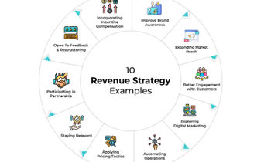
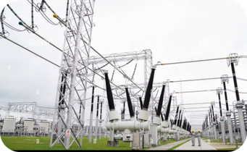
MILESTONE: FINANCIAL SUSTAINABILITY & MARKET CREDIBILITY
Building a credible, bankable regional power market requires robust financial and technical foundations.
AfSEM is advancing two flagship workstreams that form the foundational pillars for investor confidence and cross-border infrastructure finance.
LEVIES & FEES STRATEGIES
TRANSMISSION & WHEELING METHODOLOGIES
AfSEM is developing structured Levies and Fees Strategies to enhance the long-term financial viability of regional power pools and regulatory bodies.
Sustainable revenue mechanisms are essential to reduce donor dependency and ensure regulators can operate with full independence and authority.
The development of Transmission and Wheeling Methodologies and Guidelines is underway — a critical enabler for transparent cross-border trade, tariff predictability, and investment bankability.
These tools provide the technical and financial certainty that lenders, developers, and offtakers require to commit capital at scale.

Slide 16
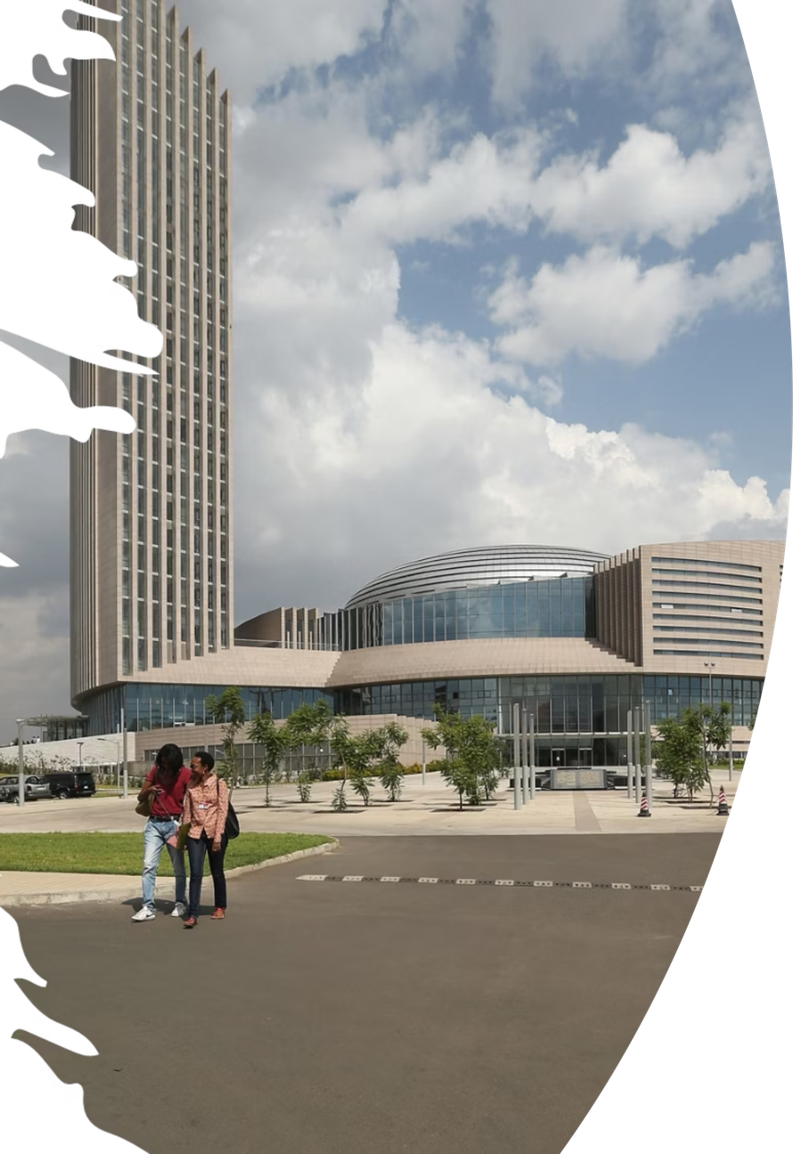

THANK YOU
MERCI · شكرا · OBRIGADO · ASANTE
African Union Commission | Department of Infrastructure and Energy
African Single Electricity Market (AfSEM)

