Slide 1

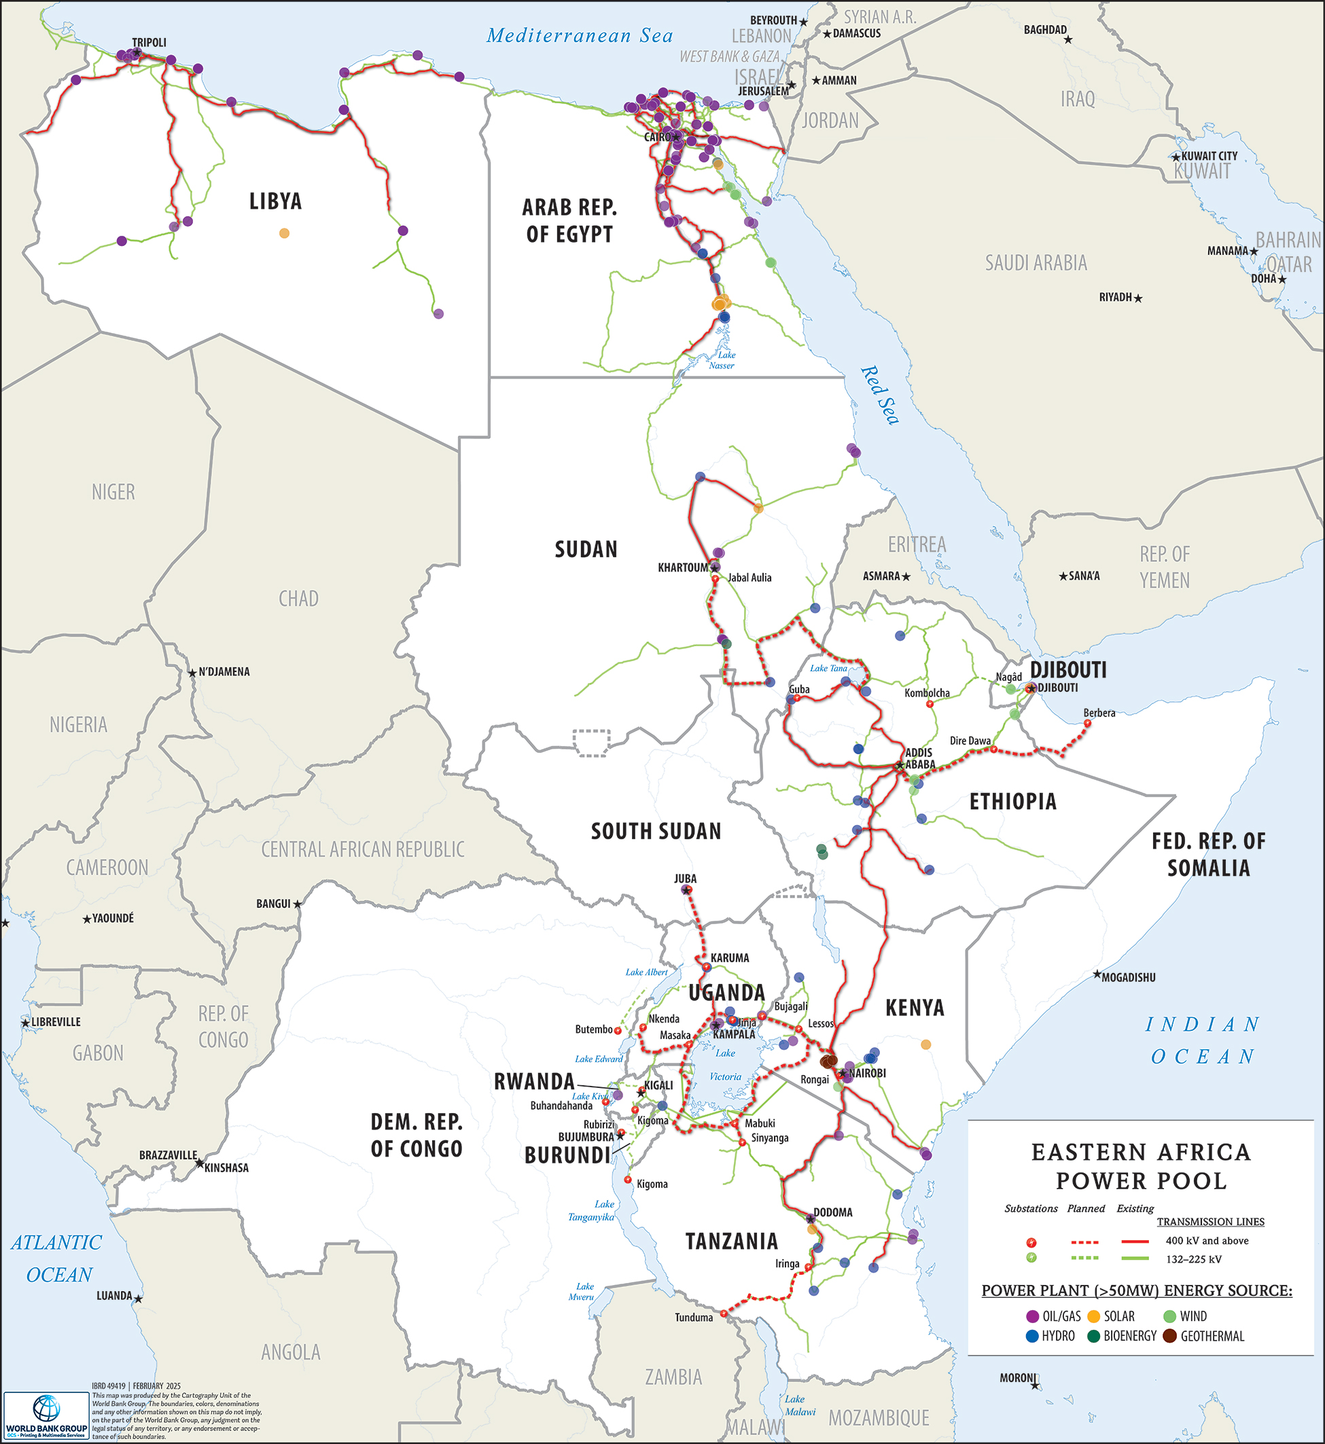

World Bank support for the Eastern Africa Power Pool
Proposed RETRADE-EA MPA
Regional Energy Transmission, Trade & Decarbonization — Eastern Africa | MPA 2026–2036
PDO: Increase electricity connectivity and trade in the Eastern Africa Power Pool (EAPP)
PROGRAM FRAMEWORK
Program Area 1 — Hard Infrastructure
Program Area 2 — Soft Infrastructure
Cross-border interconnectors
National grid reinforcements
Private capital mobilization
Regional power market operations
Regional operational, planning, and regulatory frameworks
Institutional strengthening
THEORY OF CHANGE
Inputs
Activities
Outputs
Outcomes
IDA financing
Co-financiers
TA & guarantees
Build transmission
Strengthen market
Mobilize private $
km of lines built
DAM operational
Regulatory rules
↑ Trade
↓ Energy costs
↑ Grid resilience
IMPLEMENTATION PHASES (indicative)
Phase 1
Phase 2
2028 -
Phase 3
2026–
2027 –
UTIP + RTMP
Uganda-DRC Interconnection
Burundi-TZ Interconnection
National transmission strengthening, including ITPs
Ethiopia-Somalia Interconnector

Slide 2



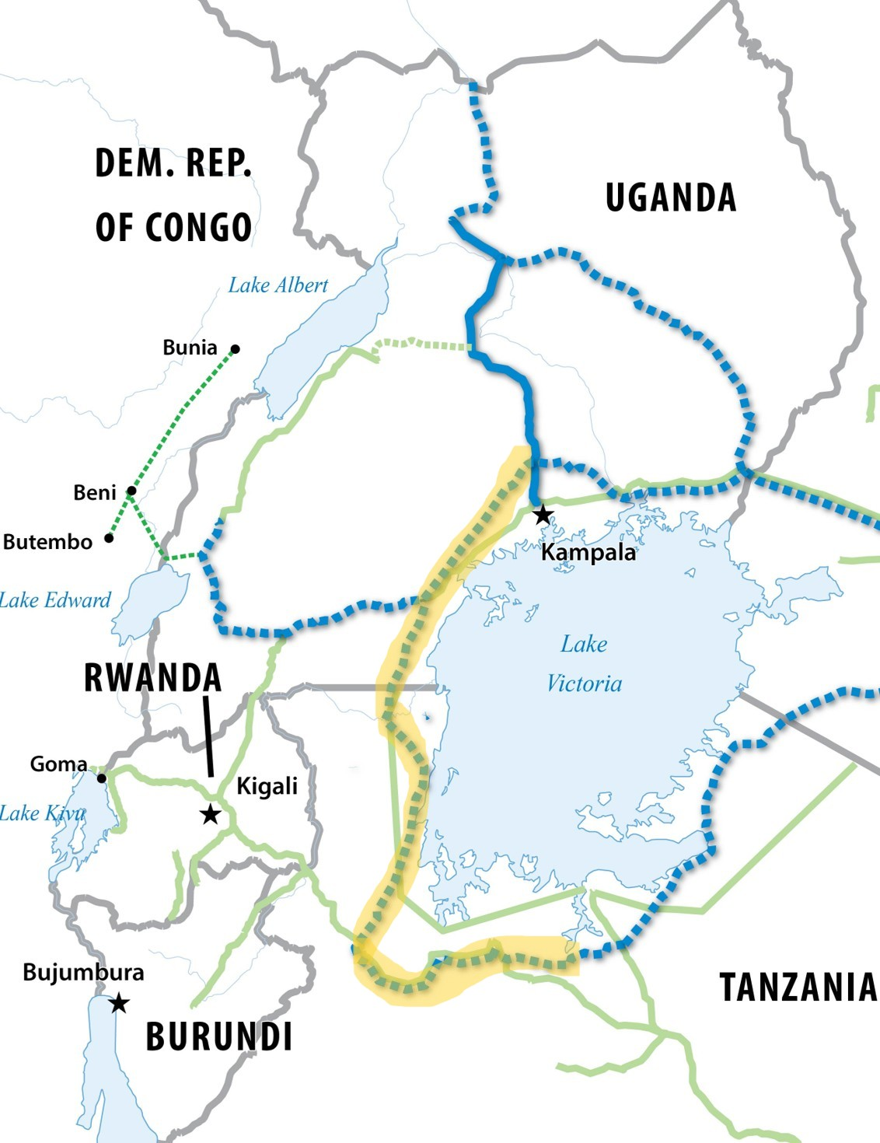




World Bank support for the Eastern Africa Power Pool
$1.84 billion
over 5 years (2026–2031)
Proposed RETRADE-EA — Phase 1
HARD INFRASTRUCTURE
SOFT INFRASTRUCTURE
Uganda–Tanzania Interconnector (UTIP) (proposed)
Regional Trade & Market Project (RTMP) (proposed)
$660 million co-financed with AFD, EU and JICA
$13.5 million | IDA + ESMAP (funded by UK-DESNZ)
Building the Western transmission corridor
Regional Day-Ahead Market
DAM post-launch ops, transmission pricing & Market Operator support
400 kV
Grid Operations
double-circuit
EAPP Interconnection Code update, grid sync & operator certification
Planning & Infrastructure
1,000 MW
Regional power system database, feasibility studies & PPP prep
transfer capacity
Institutional Strengthening
EAPP GS capacity, governance, transparency & women's leadership
807 km
Regulatory Framework
IRB market surveillance, licensing rules & national regulatory harmonization

