Slide 1
ESMAP Webinar: The African Power Pools: Building Towards the African Single Electricity Market
Presentation by SAPP Coordination Centre Executive Director
March 2026

Slide 2
Presentation Outline
EAPP and SAPP Market Coupling
SAPP Membership and Trading
Operational Challenges
Capacity Building

Slide 3
Introduction
Market coupling of the SAPP and EAPP refers to the coordinated matching of supply and demand across the two power pool markets via a shared day-ahead market (DAM) tool, optimizing cross-border trade and network usage
Worth noting that the SAPP regional electricity market is fully operational while the EAPP market is expected to be launched this year. Both power pools have established governance documents for the governing of the operations of the electricity markets
The EAPP has implemented a trading platform using the same vendor that developed the SAPP trading platform. This is expected to make the coupling a bit easier but there is some work that still needs to be done to ensure alignment.
The EAPP and SAPP have established the Operational Readiness Implementation Team, which includes the Markets Task Team to ensure optimal coupling of the two markets

Slide 4
Markets Task Team TORs
The duties of the Markets Task Team shall include, but not limited to the following:
Harmonise market rules
Harmonise Energy imbalance procedures
Determine Inter pool transmission capacity allocation procedure
Recommend Market coupling arrangements between EAPP and SAPP
Determine market surveillance activities between EAPP and SAPP

Slide 5
Coupling Options
An initial study on the coupling of the EAPP and SAPP Markets considered the following coupling options:
EAPP Order Collection model: EAPP operates a simple order collection system from the EAPP members to create one common bid for import/export towards SAPP and either EAPP or a dedicated unit under EAPP is then a member of SAPP and responsible for the scheduling of the results from this; No longer applicable with EAPP expected to operate their own market soon
SAPP/EAPP Loose Coupling model: SAPP and EAPP operate separate market trading platforms and a coupling solution between the two is developed. There are two sub-options to this; both requiring the development of a coupling system:
Both power pools use the same market trading platform system and a new system module is created to couple the two;
Each have their own (different) market trading platforms and a new system module is created to couple the two.
SAPP/EAPP Tight Coupling model: EAPP buys access (and operation) to the SAPP Market Trading platform, operates the internal EAPP markets, but uses the same gate closure time as SAPP and the markets are coupled through an implicit auction;
SAPP/EAPP Implicit model: EAPP joins the SAPP markets and participates under the same conditions as the current SAPP members.
NB: EAPP/SAPP Markets Task Team to propose recommendations on optimal coupling options

Slide 6
Market liquidity, and facilitating the participation of new market players

Slide 7
SAPP Membership Categories
Following the directive by SADC Ministers to open SAPP membership to independent players SAPP revised its membership categories to accommodate this. This improves market liquidity.
National Power Utility - meant to recognize members entrusted by Governments for SAPP ownership
Operating Member – meant for members whose operations have a significantly high impact on the SAPP Grid (cut-off being 300 MW capacity)
Market Participant – meant for members whose main objective is to trade on the SAPP markets (cut-off being 5 MW capacity)
Conditional Member – applicants with projects in planning or under construction

Slide 8
Current SAPP Members
National Power Utilities (12)
Operating Members (6)
Market Participants (7)
Summary of SAPP Membership:
A total of 25 SAPP Members:
8 from Zambia,
3 from Mozambique and 3 from Zimbabwe,
2 each from DRC, Namibia
1 each from the rest
11 Conditional Members
Notes:
First line DRC-Zambia (HVDC) in the 1950s EFM Players - generators, retailers, financial intermediaries and speculators such as hedge funds.
Zambia- Zimbabwe 1960s Manage price risk
Mozambique-South Africa – 1975 More generally, the markets create price signals for energy infrastructure investors and provide a means to secure the
future earnings streams needed to underpin investment

Slide 9
SAPP Membership – Conditional Members
Schonau Solar Energy (Pvt) Ltd of Namibia
Innosun Energy Holding (Pvt) Ltd of Namibia
Galen Energy (Pvt) Ltd of Namibia
Eenghono Power (Pvt) Ltd of Namibia
Nathaniel Maxuilili Power Plant Proprietary Ltd of Namibia
Terasun Energy (Pvt) Ltd of Namibia
OLC Solar Energy Corporation (Pvt) Ltd of Namibia
H2WS Energy of Namibia
Tati Power (Pvt) Ltd of Botswana
Tsamela Solar of Eswatini
TD Energy of Zimbabwe

Slide 10
The SAPP Interconnected Grid – Regional Integration
DRC
(SNEL)
TANZANIA
(TANESCO)
ANGOLA
(RNT)
ZAMBIA
(ZESCO/CEC/NECL/LHPC
/GPSL/MCL)
MALAWI
(ESCOM)
NAMIBIA
(NAMPOWER)
ZIMBABWE
(ZESA)
MOZAMBIQUE
(EDM/HCB/MOTRACO)
BOTSWANA
(BPC)
Future Interconnectors
ESWATINI
(EEC)
SOUTH AFRICA
(ESKOM)
LESOTHO
(LEC)

Slide 11
Some Challenges . . . . . . . . . . .
Transmission Constraints – Coordination of the planning and operations of the regional transmission Grid, adequate project preparation (SAPP Project Advisory Unit), project financing – Regional Transmission Infrastructure Financing Facility (RTIFF) – Member States accommodate private sector participation
Trading deficit – buyers in the market fail to get power they are looking for ( need for more generation and transmission interconnectors)
Generation Constraints – need for more generation - financial markets development and use of markets to underpin generation investments – enabling investment environment in Member States
Market Liquidity – need to increase number of participants – Member States to have regulatory frameworks to enable developers and improve domestic
markets including allowing open access to the transmission network

Slide 12
Operational Challenges
Transmission congestion on both interconnectors and domestic transmission networks.
The interconnection of non-operating members.
Effect of Intermittency of Renewable Energy Technologies
Upgrade of transmission infrastructure to accommodate increasing renewable energy

Slide 13
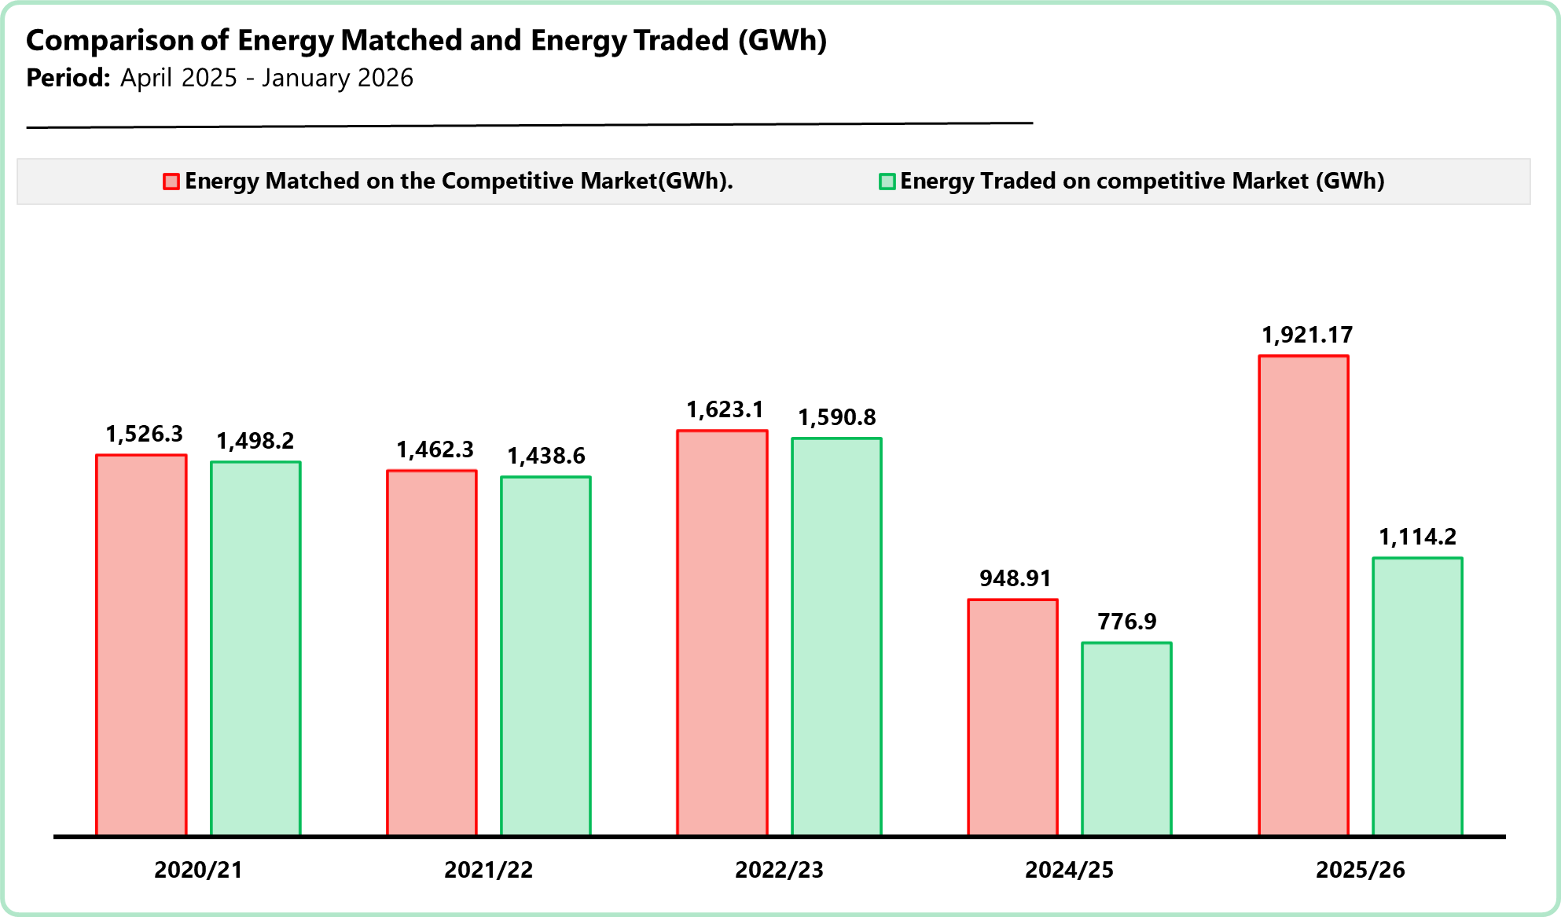
Market liquidity – Volumes
SAPP Matched and traded volumes shown – difference shows impact of transmission constraints
EAPP Markets yet to be launched
*The traded volumes for the 2025/26 financial year are from April 2025 to January 2026

Slide 14
Capacity constraints in the region and need for sustainable capacity building programs – Markets

Slide 15
Markets Challenges
Matching – price/volume mismatch
Transmission constraints
Supply side – especially during peak hours
Market Players – some dominant players
Financial Position of some Utilities (Creditworthiness and Cashflow) – affected by end use tariff
Access to USD – process can be long

Slide 16
Sustainable Capacity Building Programs – Markets
Identified capacity building programs:
Advanced Market Operations and Market Design
Advanced market clearing algorithms
Market trading simulations
Advanced congestion management
Market design principles
Market Analytics
Advanced Market intelligence – data collection and analysis
AI assisted market data analytics
Market Regulation and Power Market Reforms
Regulatory compliance
Interplay between regional market and national markets
Electricity Trading Strategies
Load forecasting
Renewables forecasting
Bidding strategies
Portfolio optimization
Electricity Security and Cross-Border Trading
Transmission scheduling and allocation
Improved Certification Programme
Training content
Accreditation of certification
Training on future market products
Electricity Financial Market
Regional Renewable Energy Market
Regional Carbon Market
Regional Ancillary Services Market

Slide 17
Sustainable Capacity Building Programs – Regional Grid Operations
Grid Planning to cater for Variable Renewable Energy.
Interconnected Power System Operations.
Variable Renewable Energy, Integration and Trading – Green Climate Funding consideration.
Cross border projects prioritization.
Transmission wheeling best practices.
Transmission transfer capacity determination

Slide 18
Thank you
Corporate: info@sapp.co.zw
Markets: markets@sapp.co.zw
Corporate: www.sapp.co.zw
Markets : www.sappmarket.com
Corporate: +263 242 335558

