Slide 1
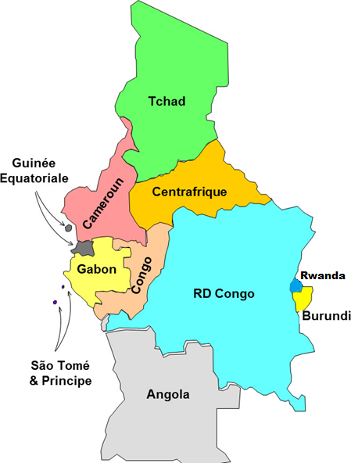
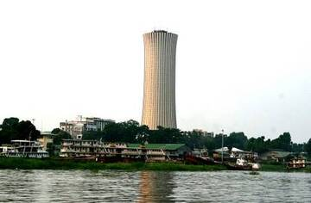












POOL ENERGETIQUE DE L’AFRIQUE CENTRALE
P. E. A. C.
Institution Spécialisée de la Communauté Economique des Etats de l’Afrique Centrale (CEEAC)
VIRTUAL WEBINAR ORGANIZED BY THE AFRICAN UNION AND WORLD BANK
11 mars 2026
CAPP PRESENTATION
TCHADELEC

Slide 2
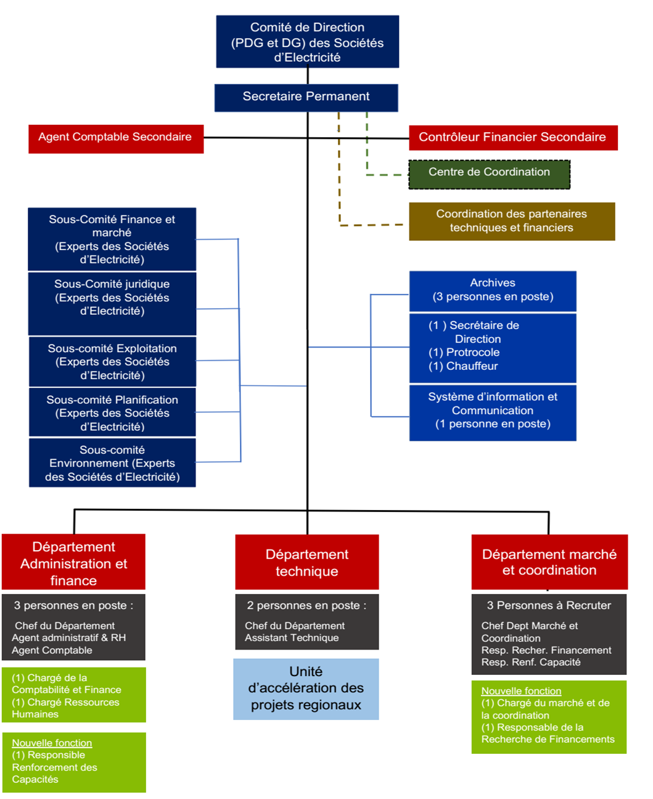
Institutional and Governance Framework of CAPP
History of Establishment
1983 : Treaty establishing ECCAS (protocol on cooperation in the field of energy among ECCAS Member States)
2003 : Establishment of CAPP
Headquarters : Brazzaville – Congo
2004 : Granted the status of a Specialized institution of ECCAS
2021: Specialized institution of ECCAS Membres : 11 countries, 13 utilities
CAPP Organigram

Slide 3
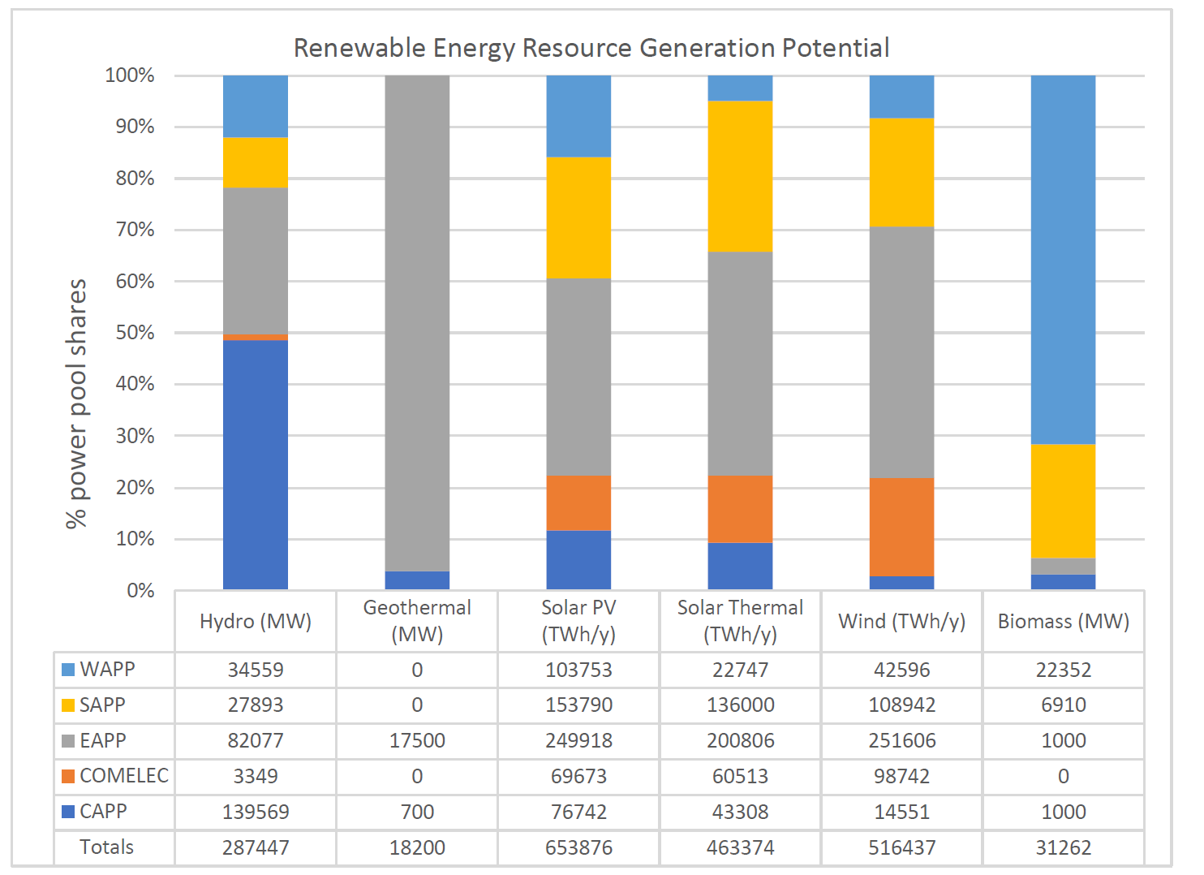
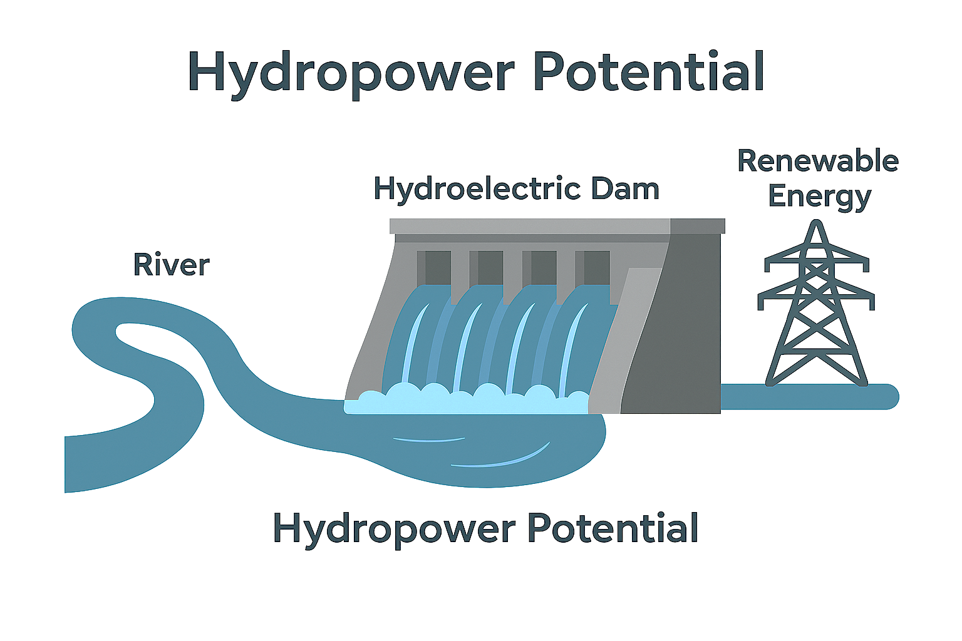
CAPP HYDROPOWER POTENTIAL

Slide 4
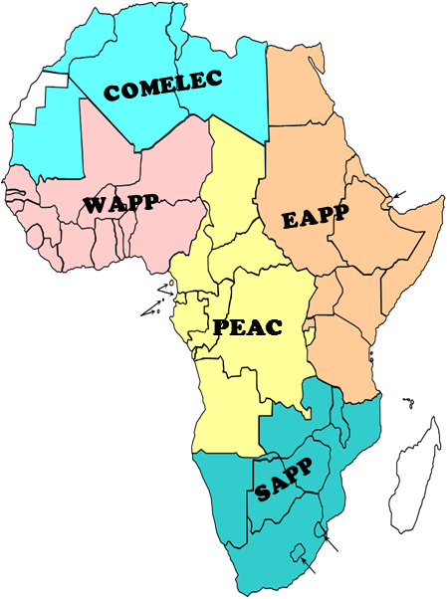
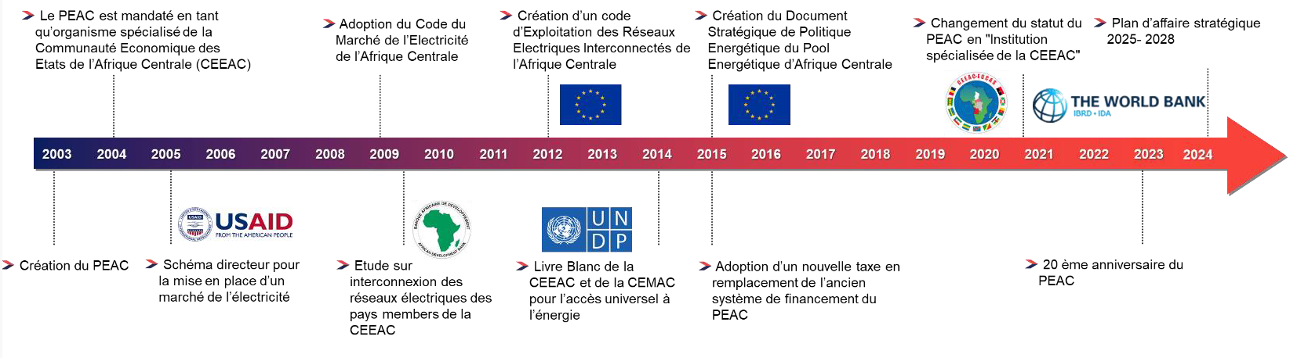
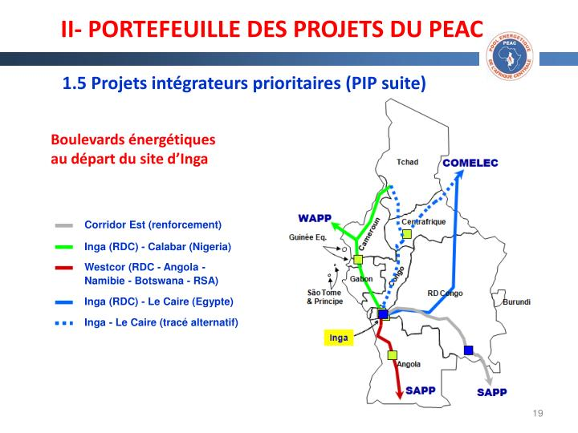
Relevance of Regional Integration
Quelques concours des PTFs au PEAC de 2003 à 2018
Position du PEAC et les corridors vers les autres Pools

Slide 5
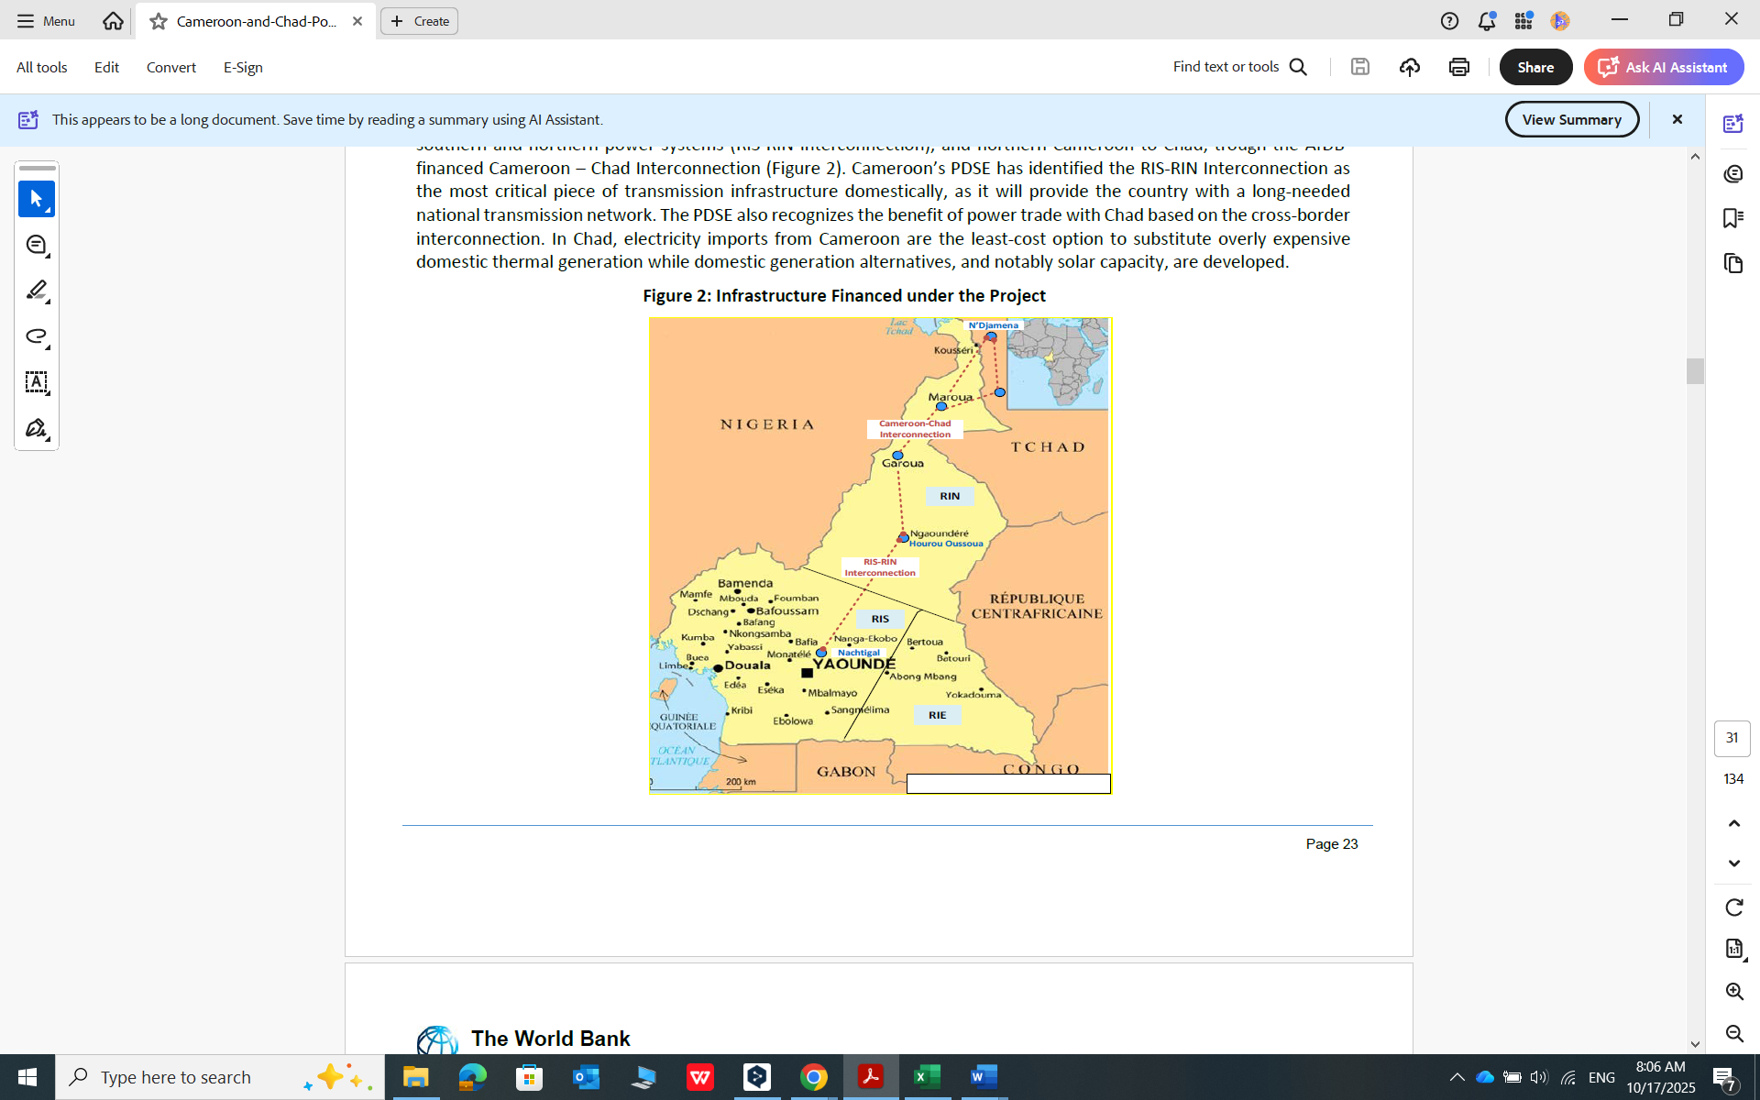
Recent noteworthy development
Preparation and adoption of CAPP Strategic Business Plan 2025-2028 in 2024, financed by the World Bank;
Preparation of the CAPP Mater plan, currently ongoing, financed by the AfDB in collaboration with the World Bank-expected adoption by end of 2026;
Pre-feasibility study of MV cross-border interconnections between Cameroon-CAR, Cameroon-Gabon, Cameroon-RoC, and Gabon-RoC) in 2025
Technical feasibility study of the Energy friendly HV loop, Pointe-Noire-Brazzaville-Kinshasa section, financed by the European Union- expected completion by August 2026;
Study of the HV interconnection of the electricity networks of Equatorial Guinea and Gabon (Mongomo-Oyem-Makokou) (Detailed study validated in february 2025)
Cameroun-Tchad HV Interconnexion Project-Expected commisionning date 2028/2029

Slide 6
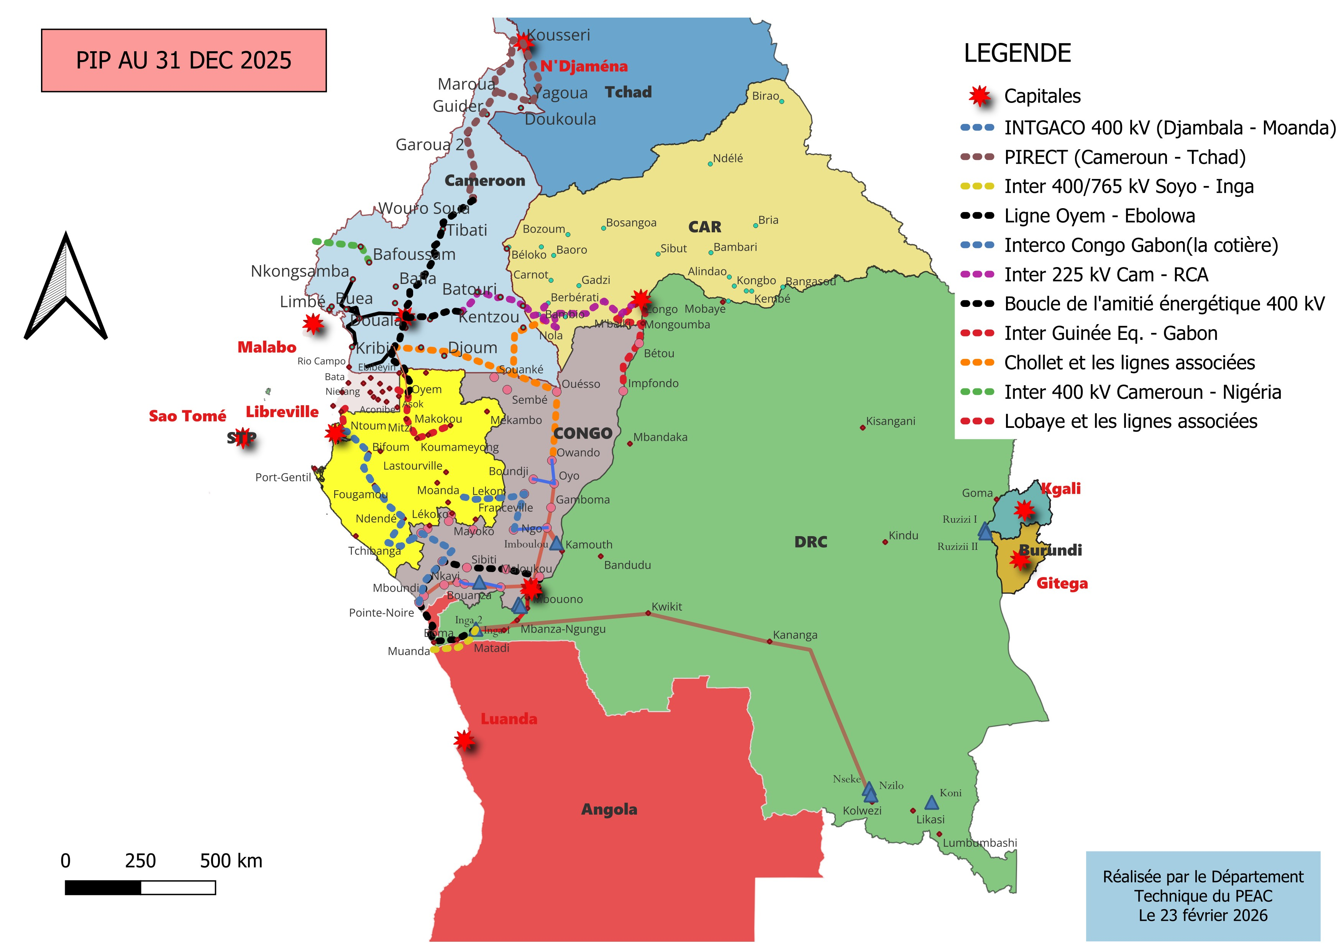
Key challenges and Priorities
Key challenges
Priority HV Regional Interconnexion Projects
Contribute to the development of regional projects;
Strenghten the technical and human capacities of CAPP and of stakeholders within the institution framework;
Support the operationalization of CORREAC ;
Further develop technical and commercial rules;
Promote the mobilization of financing for regional projects
N.B: The line itinerary will be adjusted , it is just indicative

Slide 7
Multi-Phase Programmatic Approach to support the CAPP with World Bank Financing. Indicative Financing US$ 1.1-1.4 B
The design envisaged a implementation in two or three phases for a period of 10 years (2027-2037)
Pillar 1
Piliar 2
Pillar 3
Strengthtening institutional capacity
Expanding electricity access
Augmenting Regional integration
TA for preparation of governance and regulatory documents for the regional electricity market
TA for the elaboration of a strategy to deploy capacity building in the medium to long term
TA to prepare the CAPP Market Coordination Center
TA for feasibility studies, safeguard assessments for distribution-related projects
Distribution grid investments from the interconnection lines as well as service connection densification in existing grids to augment access to electricity
Medium Voltage cross-border projects to provide access to border communities to augment cross-border trade
TA for feasibility studies, safeguard assessments for new interconnection projects
Transmission grid investments to (i) interconnect national power systems (ii) reinforce national transmission systems to support power exchanges among countries
Wapp-CAPP interconnection high level assessment
Private Sector Participation (IFC, MIGA)
Capacity Building and Implementation Support
Collaboration with others Technical and Financial Partners

Slide 8

Comments ET questions

