Slide 1


WEST AFRICAN POWER POOL
ESMAP WEBINAR: THE AFRICAN POWER POOLS:
Building Towards the African Single Electricity Market (AfSEM)
Abdoulaye DIA
Secretary General, WAPP
Mach 2026

Slide 2
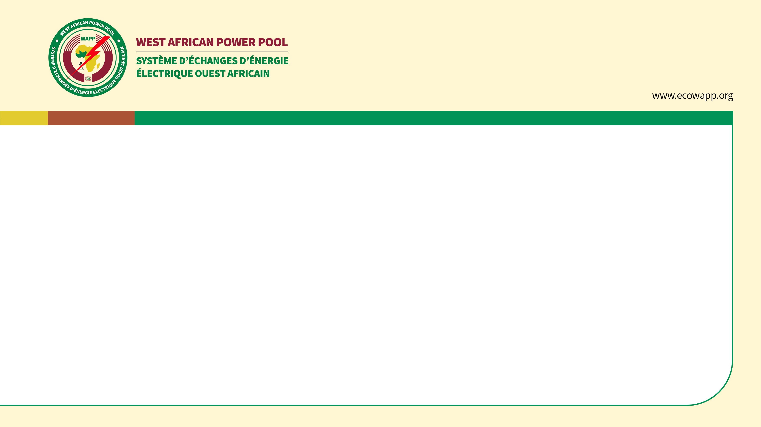
PRESENTATION OUTLINE
1- The West African Power Pool
2- The regional infrastructure program
3- The synchronization project
4- Status of the implementation of the Day-Ahead Market (DAM)
5- The main milestones and challenges of the Market

Slide 3
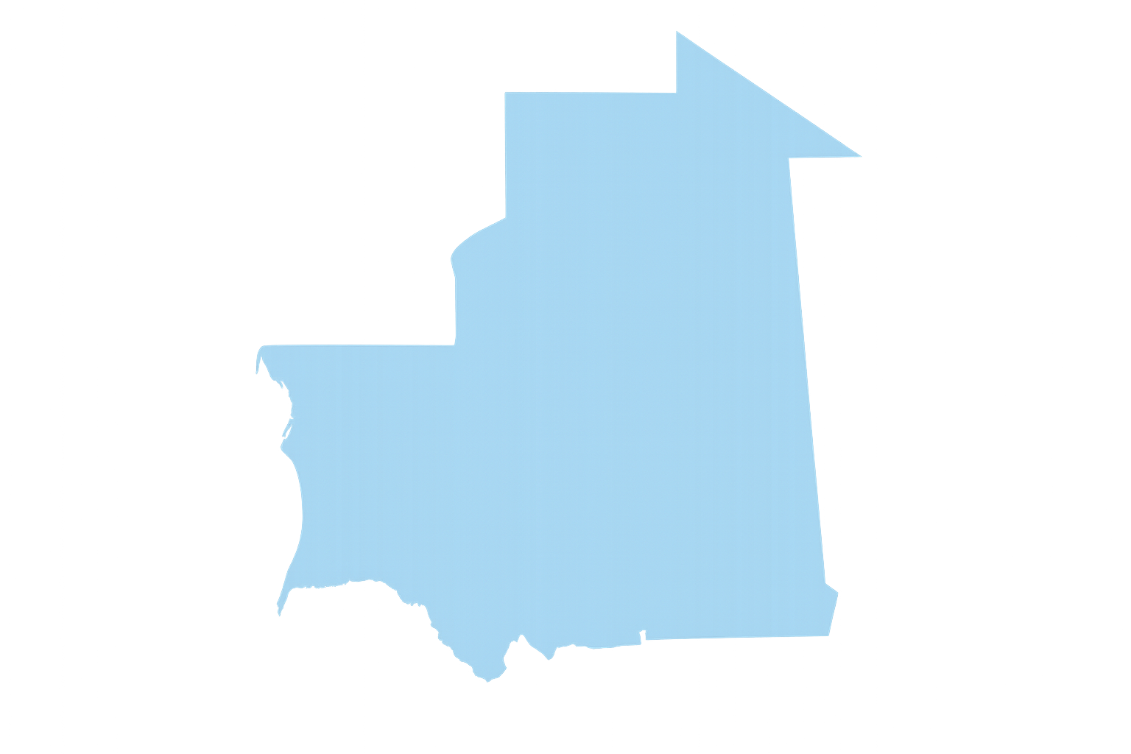
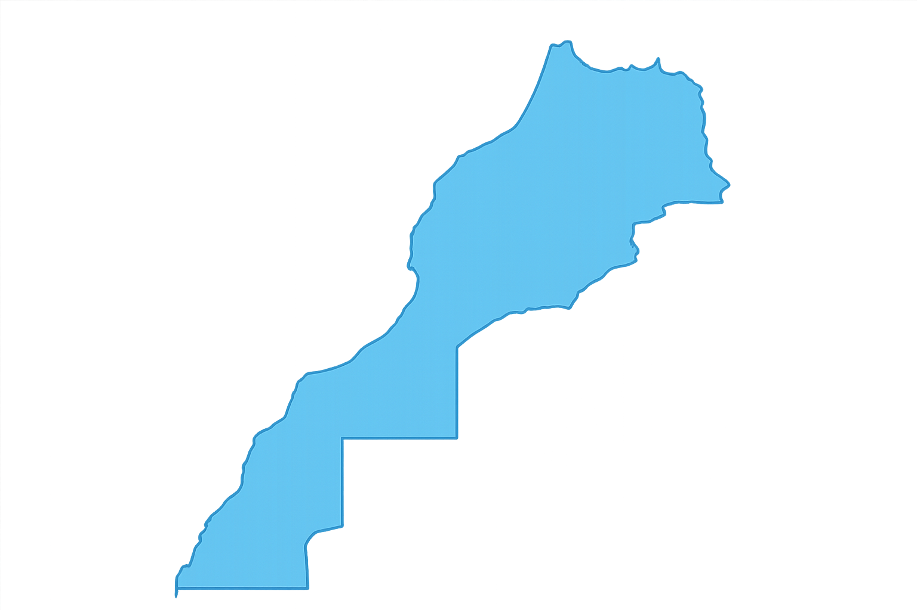
The WEST AFRICAN POWER POOL
WAPP members in January 2026 (57#)
MOROCCO
MAURITANIE
1
1
MALI
3
NIGER
1
3
THEGAMBIA
1
SENEGAL
2
GUINEE
BISSAU
1
1
BURKINA FASO
GUINEE
12
2
21
1
3
3
WAPP members in July 2006 (13#)
SIERRA
LEONE
  NIGERIA
1
GHANA
BENIN
CÔTE
D’IVOIRE
TOGO
LIBERIA
3

Slide 4

The regional infrastructure program

Slide 5
THE REGIONAL
INFRASTRUCTURE PROGRAM
Based on a low-cost investment plan for the sub-region and periodically updated
Latest Master Plan (2019-2033) adopted by the ECOWAS Heads of State and Government on 22 December 2018 through the Supplementary Act A/SA.4/12/18
75 (#) regional priority projects for the period 2019-2033, with an estimated total investment of US$36.39 billion
28 (#) transmission line projects of approximately 22,932 km of high-voltage transmission lines at an estimated cost of US$10.48 billion
  Including transmission line projects that shall enable WAPP interconnect beyond its current area of coverage – Northern Africa through Morocco, Central African Power Pool to Inga Dam
47 (#) generation projects with a total capacity of approximately 15.49 GW at an estimated cost of US$25.91 billion, comprising:
  31.1% thermal projects operating mainly with natural gas and
  68.9% renewable energy projects (10.67 GW) of which 29.5% involve Variable Renewable Energy (VRE) projects (3.15 GW solar, wind);
  VRE projects constitute 20.33 % of the total generation in the priority list

Slide 6
The Synchronization Project

Slide 7
SYNCHRONIZATION PROJECT
Statut des essais de synchronisation
  Synchronization trial: Between Zone 2 (Part of Togo/Benin – Ghana – Burkina Faso – Côte d'Ivoire – Liberia – Sierra Leone – Guinea – Part of Mali) and Zone 3 (Other part Mali – Senegal – Gambia – Guinea Bissau - Mauritania)
  ➔ Successfully synchronized since July 08, 2023 : Zone 2-3;
      Thirteen (13) countries operate synchronously
      Two (2) countries (Nigeria and Niger) operate synchronously
  Synchronization Trial of the entire power system: Between Zone 1 (Niger – Nigeria – Part of Togo/Benin) and Zone 2 - 3 (Other part of Togo/Benin – Ghana – Burkina Faso – Côte d'Ivoire – Liberia – Sierra Leone – Guinea – Mali – Senegal – Mauritania)
  ➔ Trial carried out on November 08, 2025➔ Zone 1- 2-3;

Slide 8
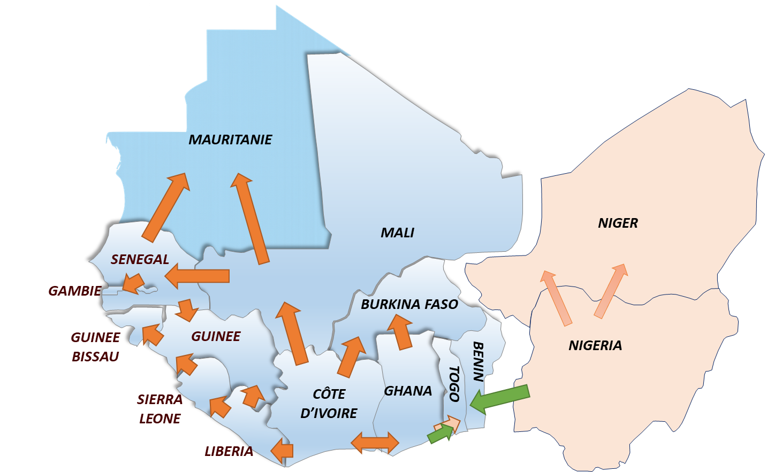
SYNCHRONIZATION PROJECT
Synchronous areas of
the interconnected
power system
Zone
1
Zone 2-3

Slide 9
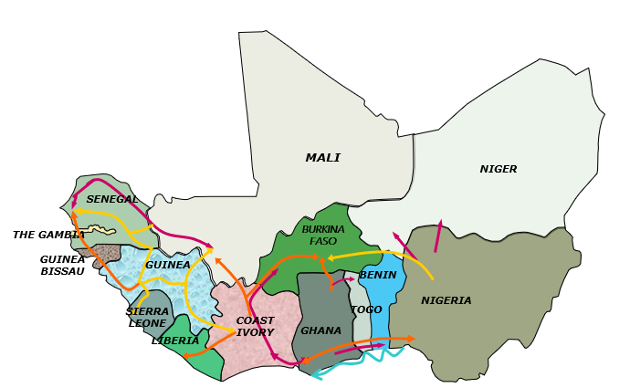
SYNCHRONIZATION PROJECT
Synchronization trial (next steps)
Synchronization trial 24-48h (Q1 2026)
Permanente synchronization (Q2 2026)
MAURITANIE

Slide 10

Status of the implementation of the Day-Ahead Market (DAM)

Slide 11
STATUS OF THE IMPLEMENTATION OF DAM
1- The Regional Electricity Market Codes of West Africa (REMC-WA)
  Status: Published by the regional regulator in September 2025.
  Overall Objective : Amend the previous market rules applicable to the Bilateral Market and introduce the rules for the Day‑Ahead Market.
2- The Regional Transmission Tariff Methodology (RTTM)
  Status: To be published by the regional regulator by the end of March 2026.
  Overall Objective : To replace the previous Transmission Tariff Methodology (MW.km point‑to‑point, flow‑based) with the Average Participation Methodology (APM), which will apply transmission charges uniformly across both the Bilateral Market and the Day‑Ahead Market.

Slide 12
STATUS OF THE IMPLEMENTATION OF DAM
3- The Construction of the Regional Information and Coordination Center (ICC)
  Status: Constructed and fully equipped, the ICC was inaugurated in November 2023.
  Overall Objective : Coordinate system operations (SCADA, EMS, WAMS) among the NCCs and provide a platform for the Bilateral Market Segment, the Day‑Ahead Market Segment, and settlement processes (MMS, AMR).
4- The Market Pilot Test
  Status: Successfully carried out from 01/08/2023 to 31/12/2023.
  Overall Objective : This test consisted of a dry run of the market involving the testing of all market procedures, including settlement and invoicing. Market Participants and Grid Operator verified the results of each market day, but no payment was required.

Slide 13
STATUS OF THE IMPLEMENTATION OF DAM
5- Selection of the Banks
  Status: Clearing Bank selected by WAPP in December 2025, and the selection of Settlement Banks by the market participants is currently ongoing.
  Overall Objective : Establish a robust settlement framework under which Settlement Banks provide financial guarantees to secure the participation of their Market Participant clients

Slide 14
KEY MILESTONES
Key dates toward the launch of the Day‑Ahead Market
Activities | Date
Market Pilot Test | 01/08 to 31/12/2023
Clearing Bank Selection (WAPP) | Aug - Dec 2025
Selection of Settlement Banks (Participants) | March 2026 - June 2026
Setting up guarantees (Participants) | March 2026 – June 2026
Regional Electricity Market Codes of West Africa (REMC-WA) | Sep 2025
Methodology and procedure of transmission Tarif | March. 2026
Market Fee Procedures | March. 2026
Marketplace Platform Modification | April 2026
Launch of Market Phase 2 ➔Effective start of the Day-Ahead Market (DAM) | 2026

Slide 15
Market Liquidity and Market Access

Slide 16
MARKET LIQUIDITY AND MARKET ACCESS
Liquidity Enhancement Revolving Fund (LERF) Project
  Funding: ESMAP Fund via the World Bank, grant.
  Overall Objective : Provide a collective guarantee to reduce outstanding bills, ensure consistent payment for energy trading, and encourage compliance with power supply agreements.
Financial Viability of Power Utilities
  Funding: Germany Government Fund via the GIZ, grant.
  Overall Objective : Strengthen the financial performance and creditworthiness of bulk buyers (especially DISCOs) to support their participation in Regional Electricity Market..
Access to the Regional Market
  Participants Categories: Grid Operators, Buyers and Sellers.
  Conditions : Regional license back by a national license and payment of Market participation fees.

Slide 17
Regional
WB engagement

Slide 18


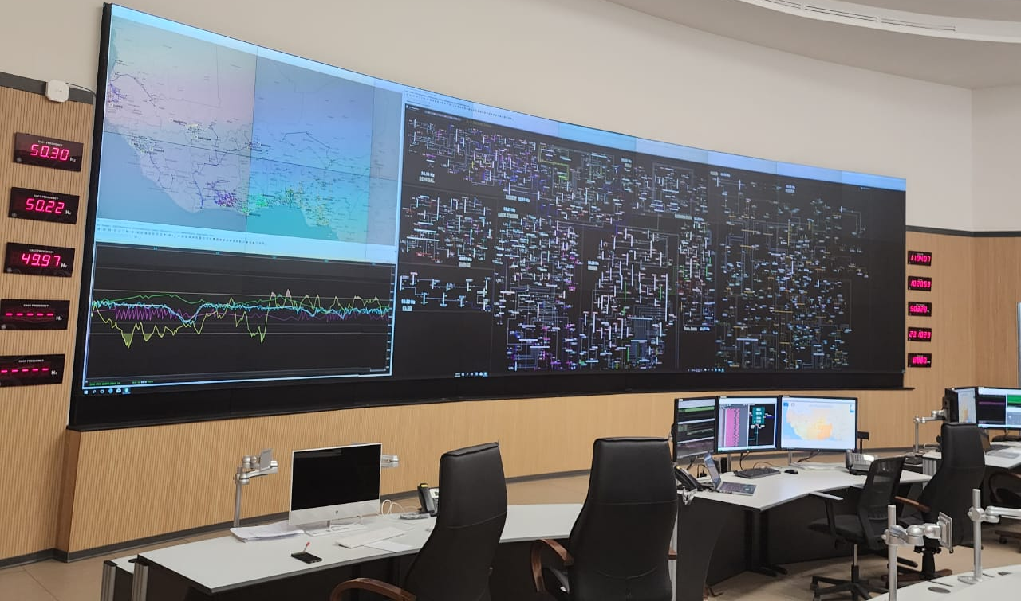
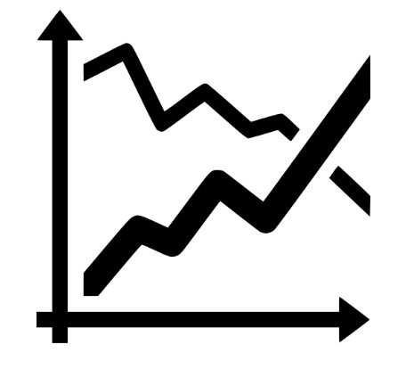

REGIONAL WB ENGAGEMENT
WB is the leading technical and financial partner of WAPP ($2 billion)
  Transmission Interconnectors (CLSG, OMVG, North Core, Guinea-Mali, etc.)
  Renewable generation (Solar development, RESPITE, Hydro)
  Market development & Institution strengthening
Consolidated Program (WA-REMP MPA) for increased trade
  Includes comprehensive assistance ($50 million grant and $2 million from ESMAP)
  Launch and operationalize the Day-Ahead Market (codes, tariff, trading platform, synch.)
  Improve liquidity and reduce risk (Liquidity Enhancement Revolving Fund - ESMAP)
Emerging Lessons
  Regional integration requires sustained commitments and trust
  Strengthening regulatory capacity is critical within WAPP
  A flexible and pragmatic approach for new market development is needed
⚡

Slide 19
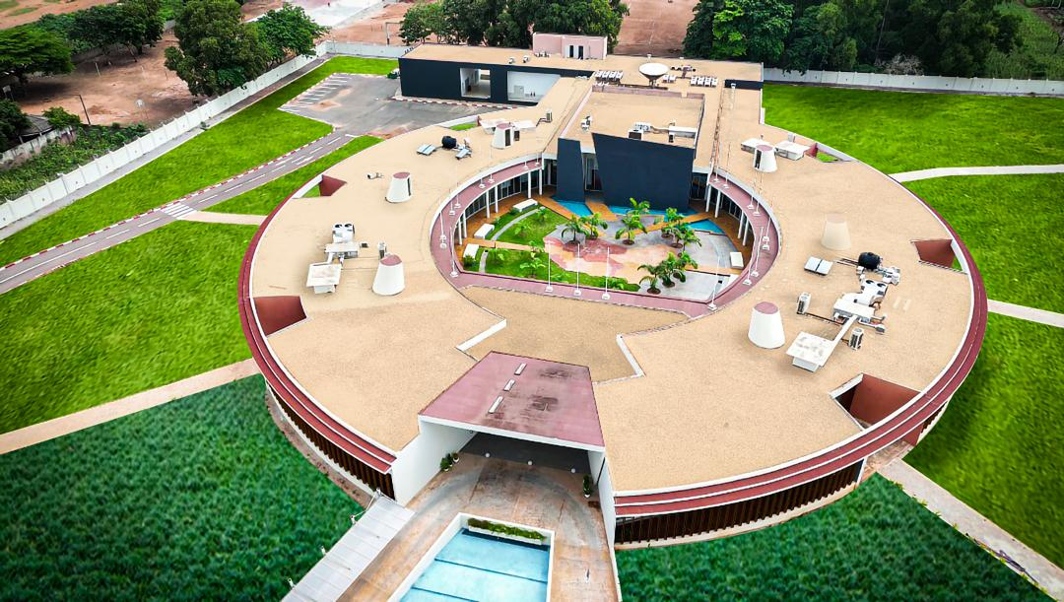
Thank You for your attention
WAPP Secretariat
BP 574 Abomey-Calavi, Republic of Benin
Tel : + (229) 91 21 52 52 / 91 21 53 53
Email: info@ecowapp.org
Website: www.ecowapp.org

