Slide 1





Subsidy Lab
Addressing Affordability and Last Mile Sustained Energy Access

Slide 2
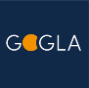


The Subsidy Lab
Energy Access Stakeholders
Contribute resources (knowledge, expertise, funding)
Subsidy Lab
Shared Outputs
translates inputs into learnings, design prototypes, tools
outputs inform designs and thinking of subsidies for energy access
Who we are, What we do
The Subsidy Lab is a collaborative platform that helps stakeholders design, implement, and scale effective subsidy and financing mechanisms for energy access.
Connecting practitioners, policymakers, donors, financiers, and private sector actors
Sharing evidence, lessons learned, and practical tools
Promoting innovation and cross-sector learning
Supporting better-designed, more effective financing and subsidy approaches
The lab is coordinated by ESMAP, EnDev, GOGLA and CCA, but welcomes the participation of all stakeholders.
Resource hub online: https://gogla.org/policy-and-regulation/end-user-subsidy-lab/
YouTube channel: https://www.youtube.com/playlist?list=PLlTeH9m13WP3s9ieWtQy2WZiZOgkUTO22
SUBSIDY LAB

Slide 3
Guidance for PAYGo RBFs: Strengthening how we Measure and Incentivize Sustained Energy Access
Agenda & Speakers
Presentation – Guidance Note on PAYGo RBFs. Alison Boess, consultant, GOGLA
Case Study – MAIS ENERGIA in Mozambique. Christian Schattenmann, Head of Energy Access, Bamboo Capital Partners.
Case Study – Ngwee Ngwee Ngwee Fund in Malawi, James Namalima, Deputy Project Manager, ASCENT, Government of Malawi.
Group discussion.
SUBSIDY LAB

Slide 4


GOGLA’s Guidance Note in Brief
Subsidy Lab Roundtable | Sept 2026
Consumer-Centric KPIs in PAYGo RBFs

Slide 5

Company behaviour and industry performance follow what funders - equity, debt, grants and RBFs - measure, reward, and fund.

Slide 6
RBFs and subsidy programs have committed $1.1 billion to off-grid solar companies and consumers.

Slide 7
All RBFs and subsidy programs aim to support sustained energy access at scale.

Slide 8
In PAYGo, energy access over time is made possible by a combination of sales and repayment, with ownership as a key milestone achievement.
Sales
Repayment
Ownership
Sustained Energy Access

Slide 9
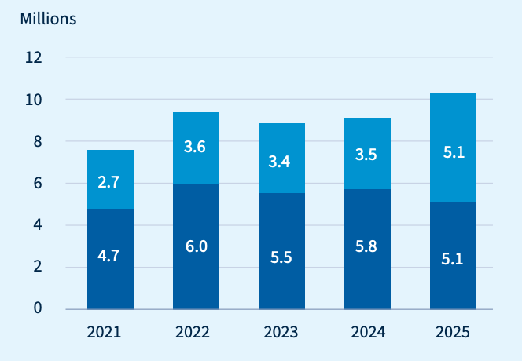
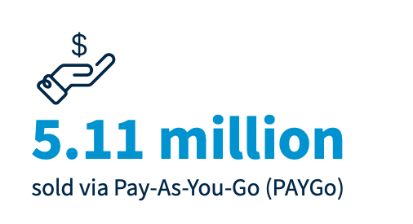
RBF programs have helped drive record PAYGo sales volumes
Sales of PAYGO solar energy kits surged by 48% to surpass 5M units, hitting 50% of SEK sales overall.
Annual Solar Energy Kit Sales, 2021 to 2025 | GOGLA
PAYGo sales
Cash sales
Source: The 2025 Global Off-Grid Solar Market Report, (GOGLA, June 2026)

Slide 10
How many of these customers will experience Sustained Energy Access?
Between 20-50% of customers never reach ownership and customers can spend 30% of PAYGo term without access
Ongoing Affordability and Access
Ownership Outcomes
GOGLA industry average*
2
days/wk with no access
GOGLA industry average*
22%
never
own
3+
days/wk with
no access
Up to***
49%
never own
Up to**
*Findings of 72% Repayment Rate and 78% Ownership Rate | Measuring What Matters: PAYGo KPIs to Drive Smarter Growth and Investment (GOGLA, 2025)
**Expert insight
***Findings of 71% Repayment Rate and 51% Ownership Rate | PAYGo at a Crossroads (MAF Lab + Acumen, 2026)
Notes:
These metrics are not usually visible within RBF programs

Slide 11
The shift to a stronger PAYGo model is underway – and RBF funds are critical partners
RBF funds
gain:
Increase in sustained energy access
More bankable companies
Stronger alignment with lenders
A clearer view
of impact
This work is part of a larger shared effort among GOGLA, investors, companies and T.A. providers to drive more sustainable performance and better outcomes for customers by changing what funders reward and measure.
This includes:
PAYGo PERFORM KPIs – Technical Guide and At a Glance (2026)
Guidance Note for PAYGo RBFs (2026)
Guidance for Company Analysis (2025)
Guidance Note for Lenders to KPIs in covenants (in development)
RBF funders and designers are a critical leverage point for sector transformation – we look to you for partnership and leadership.

Slide 12
An honest look at the gap
Across the RBF cycle, focus has been on measuring and incentivising sales of high-quality products.*
Stages in the RBF Cycle
Usage of Sales, Repayment & Ownership Data by RBF Stage
Program Evaluation
Market Mapping & Design
Incentive Verification & Disbursement
Program Monitoring & Adaptation
Company Selection
 | RBF Stage | Sales Data | Repayment & Ownership Data*
1 | Market Mapping & Design | All RBFs | Minimal
2 | Company Selection | All RBFs | Minimal
3 | Incentive Verification & Disbursement | All RBFs | Emerging
4 | Program Monitoring & Adaptation | All RBFs | Minimal
5 | Program Evaluation | All RBFs | Minimal
Repayment and ownership is almost entirely out of view
*Important recognition: RBF funds and programs have been exceptionally strong champions of product quality.

Slide 13
Measuring and rewarding sales alone creates long-term systemic issues
System-level consequences
Consumers: risk of over-indebtedness and loss of access
Companies: weaker portfolios and lower revenues
Investors: higher risk and lower returns
RBF funders: reduced impact, hidden risks, potential reputational risk, weaker value for money
Governments: loss of confidence in PAYGo and RBFs
Monitoring is key – lack of data means that the potential for negative impacts can go unnoticed and unchecked until it is widespread, highly consequential and diffcult to course-correct.

Slide 14
Insights gained by measuring Repayment and Ownership Rates
Consumer affordability, usage and ownership over time
Company financial performance and bankability
Effectiveness of programs in achieving sustained energy access
True cost effectiveness

Slide 15
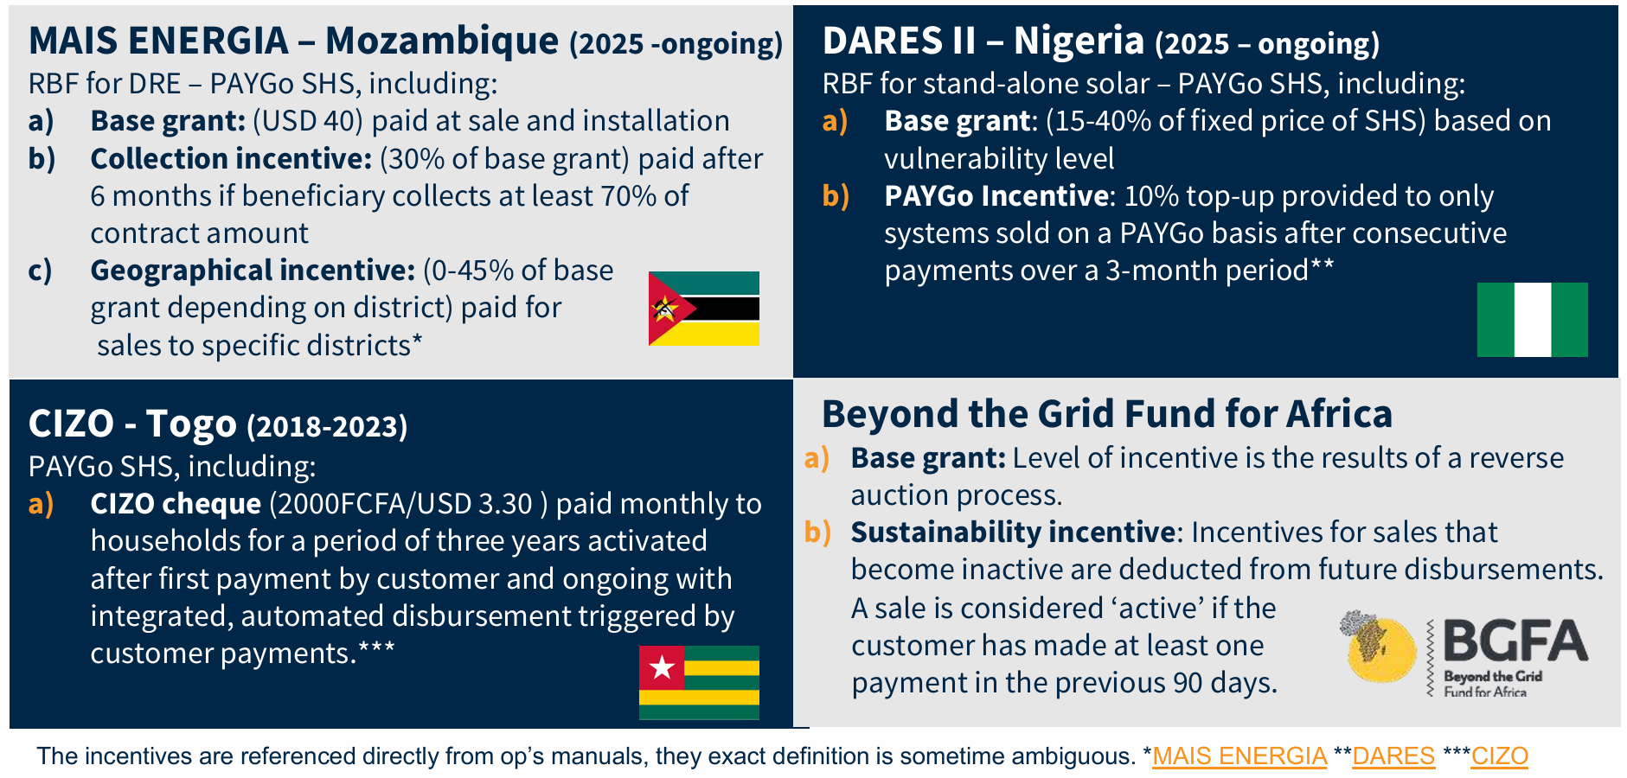
Industry funds are already using repayment/sustainability incentives
Notes:
New initiatives in the sector have emerged that recognise the problem and aim to promote long-term access with financial incentives linked to customer repayments.

Slide 16
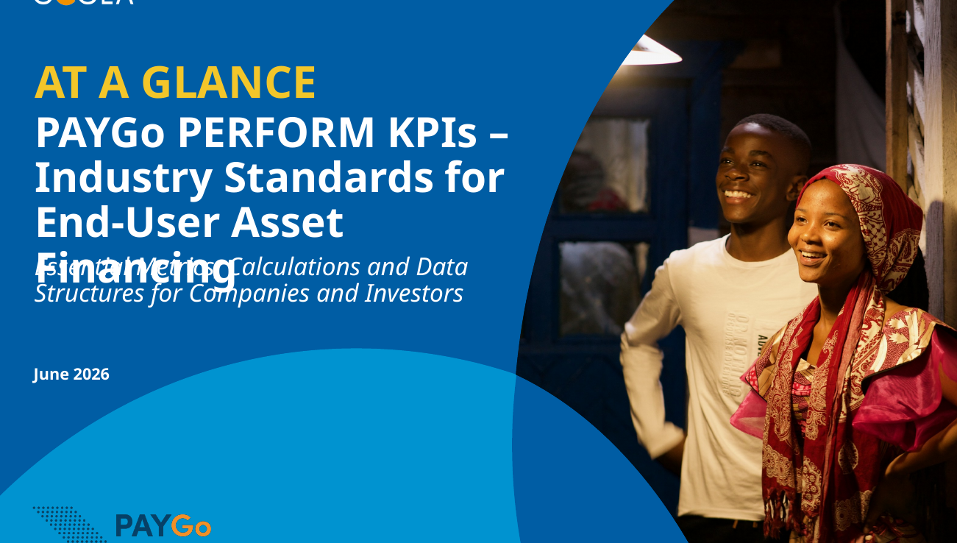
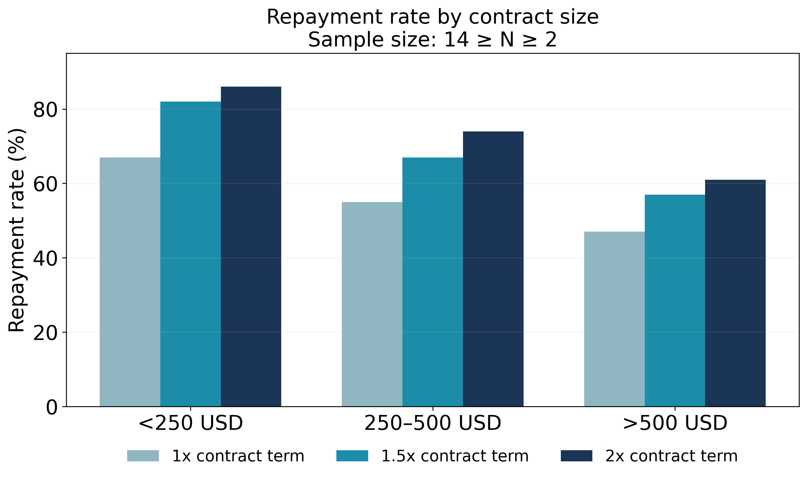
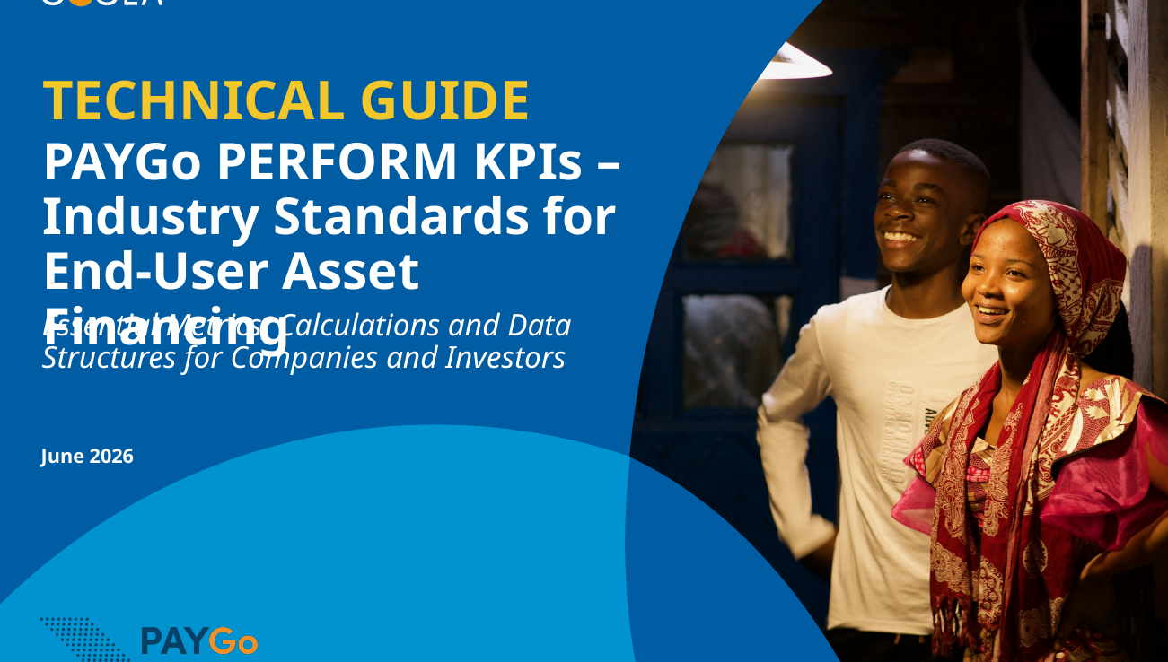
Opportunity to leverage industry KPI standards (investors, companies, etc.)
PAYGo PERFORM KPIs
At a Glance Guide
PAYGo PERFORM Monitor
Analysis from PAYGo PERFORM market data: Repayment rate varies significantly by contract size and company performance.
PAYGo PERFORM KPIs
Technical Guide
DARES II
Nigeria (2025 – ongoing)
Notes:
The incentive basis can be unclear, and metrics do not align with industry standards and common company practices, making it difficult to report, monitor, or compare to industry benchmarks.
There is an opportunity to align and leverage RBF incentive structures with industry KPIs and data initiatives (and common company practices) to facilitate efficient and meaningful digital MRV processes while promoting long-term access and company health.
PAYGo PERFORM is an industry-standard metric enabling benchmarking across countries, companies, contract sizes, and products - supporting more informed incentive design and threshold-setting.
These KPIs are already used by companies and investors, and major PAYGo data service providers can calculate and report them through dashboards based on existing CRM data (though further adoption and improvements in data quality are needed).
Aligning RBFs with these KPIs enables consistent measurement, easier reporting, and stronger alignment with private sector.

Slide 17
Call to action: embed Repayment and Ownership Rate as core metrics in fund cycle
Program Evaluation
Market Mapping & Design
Incentive Verification & Disbursement
Program Monitoring & Adaptation
Company Selection
DARES II
Nigeria (2025 – ongoing)

Slide 18
Guidance on minimum practice focuses on data gathering and monitoring
Repayment Rate and Ownership Rate
Gather baseline data during market mapping and / or company selection phases to identify technical assistance needs and inform program design.
Collect data during monitoring and adaptation phases of the program to assess performance and course correct if necessary.
Measure outcomes during post-RBF program evaluation.
Follow industry standard PAYGo PERFORM KPIs and calculations
Program Evaluation
Market Mapping & Design
Incentive Verification & Disbursement
Program Monitoring & Adaptation
Company Selection
DARES II
Nigeria (2025 – ongoing)
Incentives may be added over and above this – but this should be the minimum for all RBFs.

Slide 19
GOGLA’s guidance is not one-size-fits all → it is a context-dependent menu of options
No. | RBF Stage | Minimum Practice | + More Advanced | ++ Most Advanced
1 | Market Mapping & Design | Not strictly necessary with other minimums in place. | Use data on market level repayment and ownership outcomes to understand national performance levels and baseline capacity among companies. | Use market data and insights to: Establish targets for RR and OR. Inform TA offerings (credit risk, IT capacity) Determine whether to include repayment-based incentives and the appropriate level of thresholds
2 | Company Selection | Require companies to provide data on historical RR and OR for baseline, or to indicate that the data cannot be provided.* | Require companies to provide historical data on RR and OR (or the source data for deriving these metrics) as a precondition. | Identify specific companies for TA support (credit risk management, IT & data capacity, etc.) For markets with highly developed consumer finance practice and performance levels, use historical results as selection criteria / gating.
3 | Incentive Verification & Disbursement | Not strictly necessary with other minimums in place. | Financial incentive for RR above pre-defined level, e.g. RR at 90/180 days (for individual customers). | Design claims eligibility or incentives based on more advanced metrics (e.g. RR at 90/180 days for monthly sales cohorts).
4 | Program Monitoring & Adaptation | Require company reporting on RR and OR on all claims. | Engage companies and re-define incentive verification & disbursement triggers if needed. | Require real-time / near real-time reporting & monitoring on RR and OR performance of past claims. TA / incentives to support reporting capacity. Redirect project elements mid-way based on RR data in order to meet outcome targets.
5 | Post-Program Evaluation | RR and OR included in post-program evaluation. Findings inform future RBFs. | Publish findings on impact of program on RR and OR as part of overall success indicators. | Contribute to meta studies and other broader work on the impact of RBF programs on RR and OR.
DARES II
Nigeria (2025 – ongoing)
*NB: A company’s lack of historical data or technical inability to report key figures at selection is a useful data point (e.g. identification of TA needs).
Notes:
Will not go into details – high level only

Slide 20
We can solve for the practical risks and challenges if we are jointly committed
Risks & challenges | How to mitigate and manage
Introducing complexity (with administrative cost/burden and making funds less accessible for companies). | Tailor the design and adoption of measures to the market context and capacity of the implementing agencies. Ensure good industry consultation in the design and implementation phases of the fund.
Disbursement delays (that create cash flow issues for companies) | Blend sale and repayment subsidy. Use Repayment Rate at 90 days – this is relatively soon after the sale and has good correlation with long-term repayment and ownership. Ensure working capital loans and liquidity considerations factor in disbursement schedules.
Higher data burden (for implementers and companies) | Align with industry standard PAYGo PERFORM KPIs and calculations. Work with experienced data service providers.
Exclusion of small firms | Provide grants, TA and support from data service providers. Phased adoption in RBF funds.
DARES II
Nigeria (2025 – ongoing)
Notes:
Review topics at a high level only – noting that each of these are real but solvable if we stay committed to the will to get to sustained energy access

Slide 21

Bullet/Text frame
Change image by right clicking current one and chose “replace image”. Bullet list can be used as normal textblock as well.
We count on your leadership and partnership
How your RBF defines, measures and rewards success will shape the future of this industry and the impact and scale it can reach in the years to come.
Let’s work together to develop and refine the next wave of PAYGo RBFs - piloting these metrics, sharing lessons, and building common approaches that strengthen outcomes for consumers, companies, and funders alike.

Slide 22

Ngwee Ngwee Ngwee Fund
Embedding PERFORM KPIs in Fund Design, Monitoring and Disbursements
ESMAP and GOGLA Webinar
16 Sep 2026

Slide 23

Background
GOM has prioritized the development of the energy sector as a catalyst for achieving Malawi Vision 2063
Building on the success of MEAP, the MoE is now implementing ASCENT Malawi Project
MEAP helped to increase the national electrification rate from 14.2% in 2021 to 25.9% in 2024 and successfully established the Ngwee Ngwee Ngwee Fund (NNNF) in 2023
ASCENT will contribute 50% towards GOM strategic goal of reaching at least 70% electricity access by 2030, and of providing cleaner cooking solutions 75% of households

Slide 24
NNNF under ASCENT Malawi
Fund Size of USD 90M for Component 2, 3, and 4
NNNF
Component 2: Off-Grid Connection through SHS
USD 60M with a target of 811,000 new household connections
Component 3: Energy Access for Public Facilities
USD 20M to electrify 1,000 schools and 280 health centers
Component 4: Clean Cooking Solutions
USD 10 million to distribute Tier 3, 4 and 5 cooking solutions to 150,000 households
Grant Window
Debt Window
(USD 44M)
RBF Grant Window
(USD 16M)
Off-grid Component
Grid Connection Component
Debt Window
(USD 7M)
TA Window
(USD 3M)
Notes:
NNNF provides RBF grants and loans to Participating Organizations (POs)
Loans are critical for POs to import SHS amid Malawi's hard-currency shortages
We already monitor SHS sales/connections and PO financial health against loan covenants (e.g. liquidity ratio)

Slide 25
Disbursement of Funds and dMRV Platform
Debt will be disbursed by milestones (subject to satisfactory verification as required) to ensure the funding is used by POs for the purpose intended by the Fund.
Milestones will be set based on company’s financing needs, supplier contract provisions and invoices for stock, work orders, invoices of assets to be purchased by the companies.
Company CRM systems must support API connections with the MoE’s dMRV platform (PROSPECT), allowing full access to all relevant performance indicators and data through integration with the dMRV platform.
Notes:
MoE plans to adopt KPIs from the PAYGo Performance, Reporting and Measurement (PERFORM) Monitor.
MoE will support POs before rollout; once rolled out, POs will share data with the platform.

Slide 26
Why Monitor Beyond Sales?
How many SHS sales become SHS owned by families?
Are household repayment rates improving or deteriorating over time?
How do rates compare across companies, regions, and neighbouring countries?
Combine with IVA reports & surveys to refine the program e.g. subsidy design
IMPACT - Understanding what sales really achieve
How do sales practices translate into quality of sales over time?
Does that translate into sustainable financial performance i.e., profitability, liquidity?
Sustainable connections require sustainably-operating companies
NNNF wants durable energy access, not just a higher connections count
Financial Health - Understanding whether POs can sustain it
Our operations manual was updated to adopt PAYGo PERFORM KPIs: Company reporting on Repayment Rate (RR) & Ownership Rate (OR) during Program Monitoring & Adaptation.
NNNF's blended grant-and-loan model spans GOGLA's RR and OR to financial covenants.
3

Slide 27
What We Already Collect
1
Monthly reports & quarterly claims - Used today for sales verification and RBF reporting
Automatic CRM integration via Prospect - Prospect integrates directly with PO CRM systems for automatic reporting
Financial covenant reporting - Already required from POs receiving NNNF loans
2
3
What's Next
1
Engaging POs to understand what it would take for them to report on PERFORM KPIs
Exploring partners: our existing relationship with Prospect, and additional support from a rating company implementing the PAYGo monitor
MoE will support POs before rollout through a phased approach especially for smaller firms
2
3

Slide 28

Our key learning area from this interaction:
How are other RBF programmes collecting and analysing PERFORM-type data, and what partnership models and trade-offs have worked for them?
Thank You!
Please send your queries @
info@ascent.mw

Slide 29
The Subsidy Lab
What’s Next
Trade-offs in RBF Subsidy Design: Lessons from the BGFA Mid-Term Evaluation. September 30.
Global Off-Grid Solar Forum & Expo, 27-29 October, Kigali.
Do reach out!
We'd love to hear from you:
Share ideas, experiences, and innovations in subsidy and financing mechanisms
Explore collaboration and partnership opportunities
Seek support or exchange lessons learned from ongoing programs
Provide feedback on this webinar and future Lab activities
Contact: jtracy@worldbank.org
SUBSIDY LAB

Slide 30
Subsidy Lab Addressing Affordability and Last Mile Sustained Energy Access
Thank You for Joining

