Slide 1

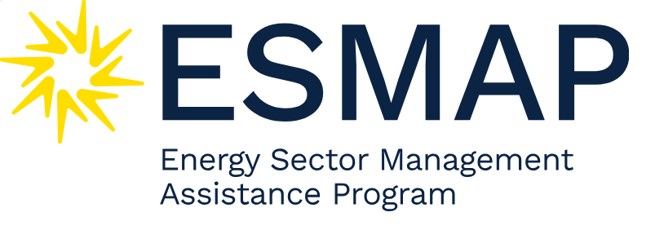
Leveraging de-risking instruments and international co-ordination to catalyse investment in clean hydrogen
Joseph Cordonnier
OECD Environment Directorate
Moongyung Lee
OECD Environment Directorate

Slide 2

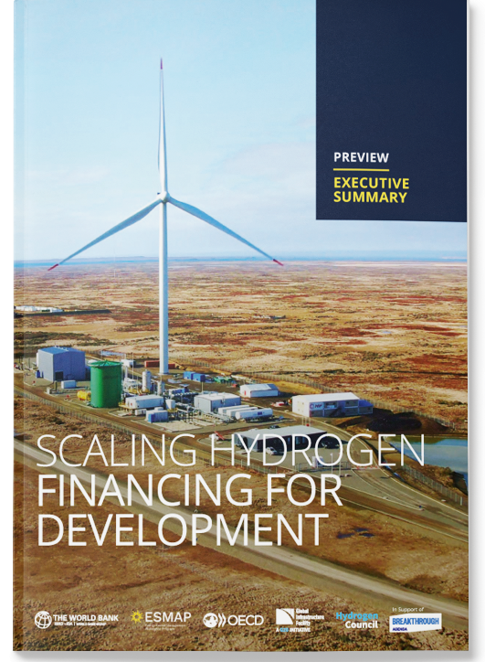
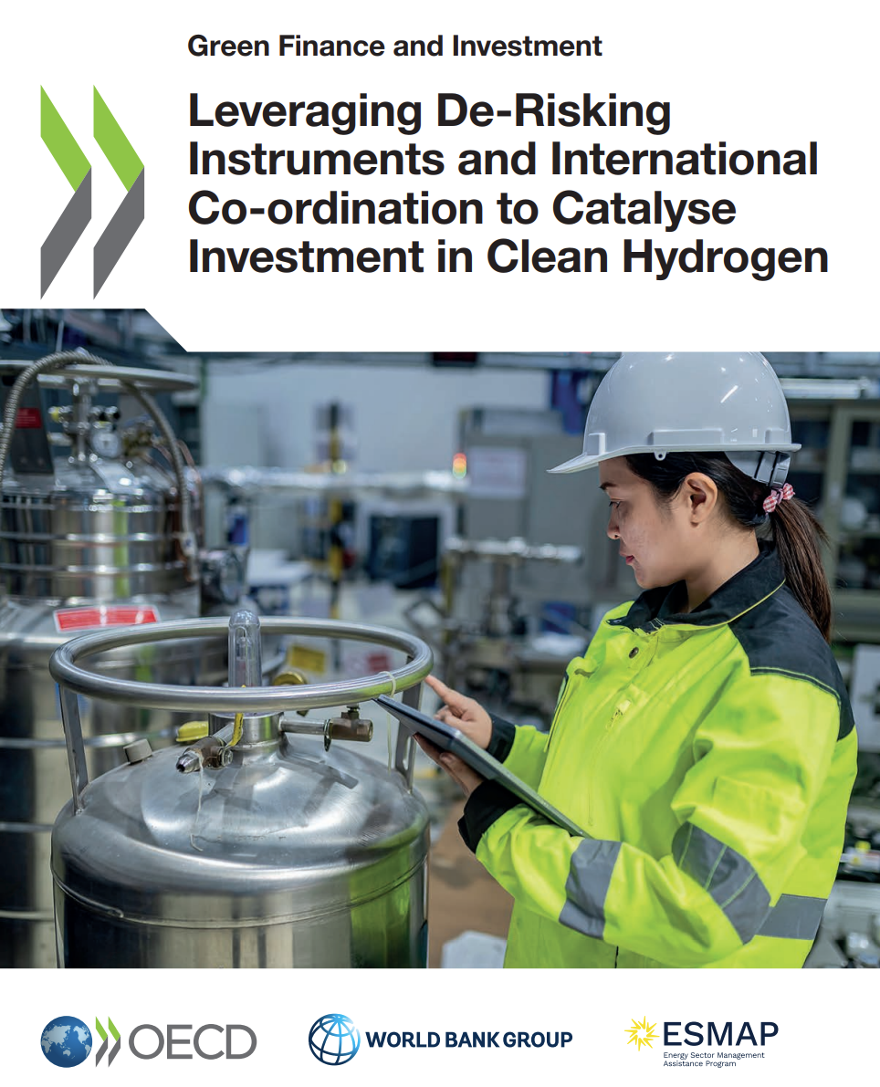
Joint efforts to ramp-up clean hydrogen financing
2022
2023
2024
10 GW initiative announced at WB/OECD report launch.
  Streamline Multilateral Development Banks financing and unite support
  Target >10 projects,
  from 100 MW to 1 GW size
  (enable ~ USD 30 billion investment)
OECD/WB new report informing the 10 GW initiative and the Breakthrough Agenda
World Bank-led initiative
44 partners, including OECD
OECD co-chair
workstream 3 on
Investment, financing, business models and procurements.
Leveraging De-Risking
Instruments and International
Co-ordination to Catalyse
Investment in Clean Hydrogen
Joint WB/OECD report
Scaling Hydrogen Financing for Development

Slide 3



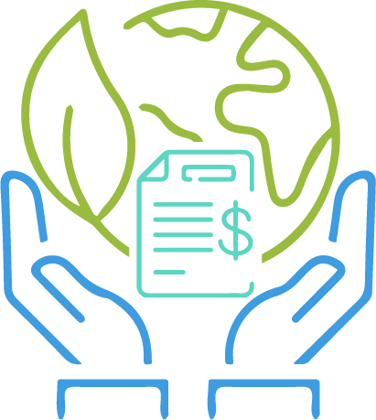
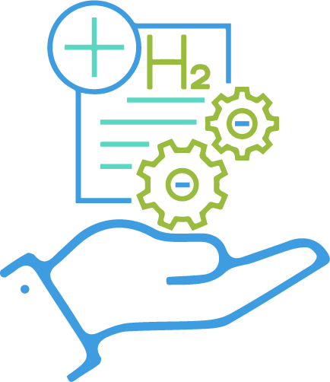
Moving Forward: 10 GW Lighthouse Initiative
Coordinate among participating institutions
Develop a knowledge hub
Identify a viable pipeline of large-scale clean hydrogen projects
CORE
ACTIVITIES
Apply concessional and climate financing
Identify and propose financial and non-financial solutions to manage risks and barriers
Deploy policy, regulatory, and financing de-risking mechanisms

Slide 4
Key messages
The key findings of the report directly inform key international initiatives
  Support Breakthrough Agenda’s priority action to enhance finance and support mechanisms (with WB & UNIDO)
  Identify key priorities for World Bank's 10 GW Lighthouse Initiative
Effective de-risking strategies require a combination of instruments
  From the investor survey carried out for this report, the most relevant instruments to attract investment are: Contracts for Difference; Offtake guarantees; Political risk insurances; Foreign currency guarantees; Technology performance guarantees
  Yet, there is no one-size-fits-all solution: instruments must be packaged to (i) balance the project’s risk-return profile; and (ii) avoid overlaps that could make instruments redundant and increase the overall cost.
The risk mitigation strategies must come with enabling conditions that create a conducive environment for investors (e.g. access to infrastructure, demand creation mechanism)
International partnerships and co-ordination mechanisms are essential to scale clean hydrogen financing

Slide 5
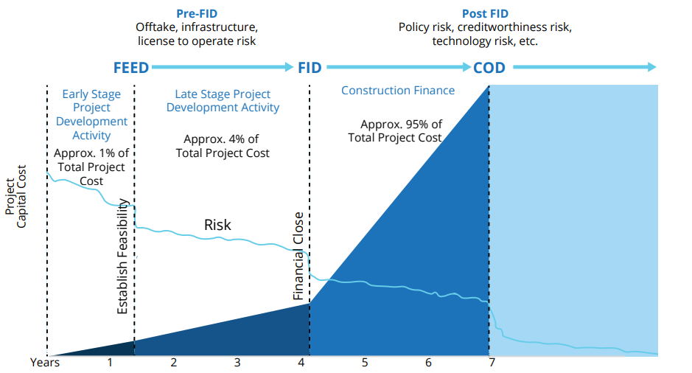
Clean Hydrogen Project Life Cycle
Risks change over the project lifecycle, calling for different mitigation instruments at each stage.
Concessional finance in the early stages of project preparation is crucial to attract debt investor
Clean hydrogen projects keep critical post-FID risks centered on EPC overruns, offtake default, technology nonperformance, withdrawal of regulatory incentives, and exchange risks.
FEED: Front-End Engineering Design; FID: Final Investment Decision; COD: Commercial Operations Date; EPC: Engineering, procurement, and construction

Slide 6
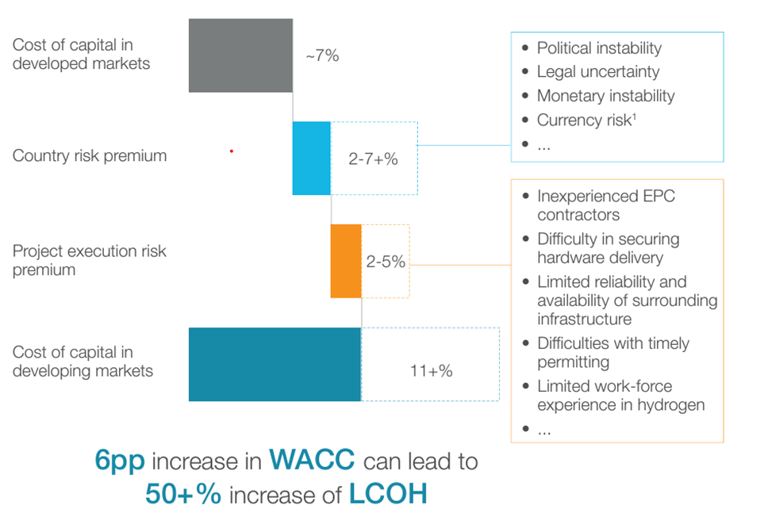
Drivers for the cost of capital for hydrogen projects in developed vs developing countries
Source: Hydrogen Council and McKinsey (2024)
Source: ESMAP, OECD, GIF, Hydrogen Council (2024)

Slide 7
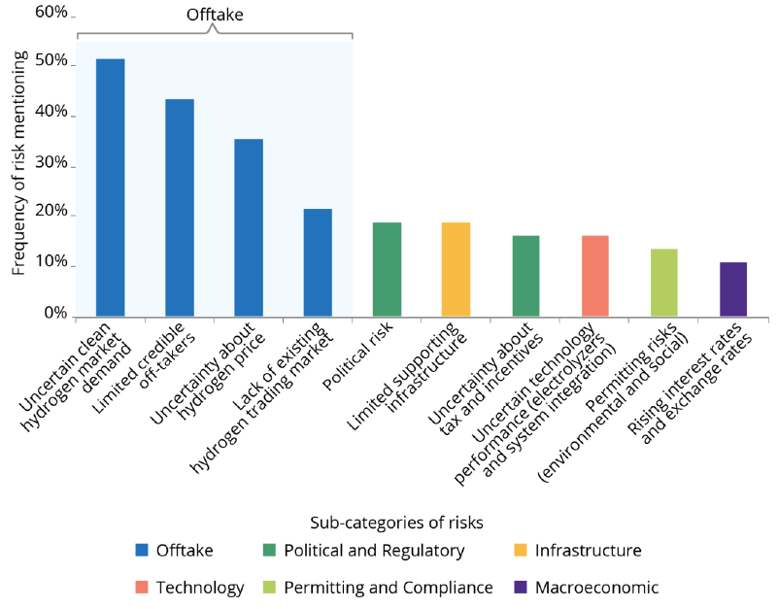
Identified key risks based on OECD/World Bank investor survey (2023)
Source: ESMAP, OECD, GIF, Hydrogen Council (2024)

Slide 8
Why Tailored Derisking instruments are needed:
Comparison of assets’ risk profile
 | Clean Hydrogen | LNG | Thermal | Offshore wind | Grey Hydrogen
Capital-intensity | High | High | Moderate | High | Moderate
Project Complexity | High | Moderate | Moderate | High | Moderate
Price risk | Yes | No, commodity price or indexed price (floating) | Moderate | Yes | Moderate or No
Significant capital costs reduction for new projects | Yes | No | No | Yes | No
Market Maturity | Low | Advanced | Advanced | Advanced | Advanced
Profitability | Low or negative | Moderate to High | Moderate to High | Low to moderate | Moderate to high
Operation risk | High | Moderate | High | Low to Moderate | Low
Revenue risk | High | Moderate | High | Moderate, depends on price contract terms/structure | Low to Moderate depends on price formula
Supply risk | High | High | Moderate | Moderate | Low to Moderate
Counterparty risk | Yes | No | No | Moderate | Low/No

Slide 9
Mapping of de-risking instruments:
Results of investor survey
← Highest risk for investors
Not relevant Very relevant
 | Uncertain clean hydrogen demand | Uncertainty about hydrogen price | Country risk | Uncertainty about tech. performance | Licensing, permitting, completion risks | Interest and exchange rates
Buyer credit guarantees
Contractors-all-risk insurance
Contracts for Difference
Credit default swaps
Foreign currency guarantee
Interest rate swaps
Liquidated damages
Loan loss reserve
Offtake guarantee
Partial credit guarantee
Performance guarantees
Political risk investment/foreign investment insurance
Syndicated loan
Offtake guarantees and Contracts for Difference are well-placed to address offtake risk (both market demand and clean hydrogen price).
Political risk investment insurance is key to address country risk
Several instruments exist to address interest and exchange rates
Survey conducted in June/July 2024, with 41 respondents.

Slide 10
Prioritisation of de-risking instruments for project financing, depending on a country’s credit rating
Survey conducted in June/July 2024, with 41 respondents.

Slide 11
How can international co-ordination scale clean hydrogen financing?
Priority areas
Joint financing of IFIs for clean hydrogen projects
International platform creation to channel capital flows towards viable clean hydrogen projects
Harmonising appraisal and procurement processes for large-scale projects
Knowledge-exchange and capacity-building on clean hydrogen financing in EMDEs
EMDEs: Emerging Markets and Developing Economies
IFIs: International financial institutions

Slide 12
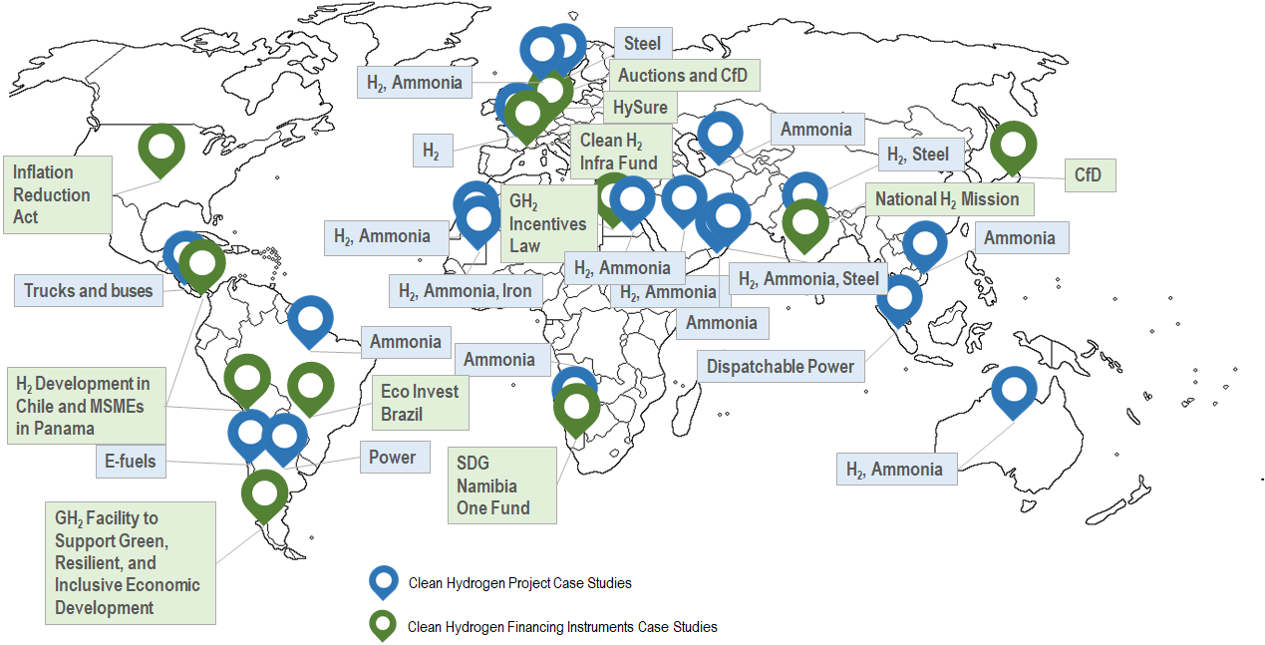
Map of Clean Hydrogen Case Studies (2022-2024)
21 case studies on
clean hydrogen projects, covering >35 GW
electrolyser capacity in
20 countries
11 case studies on economic, de-risking and financing instruments

Slide 13
Key lessons from case studies
Enabling conditions
Risk sharing
Financing
Alignment of national and regional strategies and policies
Well-structured economic instruments
(e.g. tax rebates, capex and opex subsidies)
Blended finance
(e.g. concessional loans)
Thorough feasibility study
at development stage,
benefitting from
hydrogen sector expertise
Public and private partnerships for effective risk allocation

Slide 14
Leveraging de-risking instruments and international co-ordination to catalyse investment in clean hydrogen
Joseph Cordonnier
OECD Environment Directorate
Moongyung Lee
OECD Environment Directorate

Slide 15
Building Investor Confidence: De-risking and Financing Clean Hydrogen Projects
Considering the inherent risks in clean hydrogen projects, are there de-risking tools detailed in the report that you would prioritise as particularly crucial?
Beyond the tools mentioned in the report, what de-risking strategies from other sectors have proven highly effective? How could these be adapted or applied to the unique challenges of clean hydrogen projects?
Have you seen successful examples of emerging economies attracting international finance for clean hydrogen initiatives? What specific policies or strategies did they implement to build investor confidence and secure funding? What lessons can other emerging markets learn from their experience?
How can we foster effective collaboration among financial institutions in the clean hydrogen sector while maintaining momentum on current projects? What are some best practices for balancing these competing priorities?

Slide 16
Leveraging de-risking instruments and international co-ordination to catalyse investment in clean hydrogen
Contact the authors
Joseph Cordonnier, Moongyung Lee, Joana Argemi Ribalta, Deger Saygin
OECD
Dolf Gielen, Silvia Carolina Lopez Rocha
the World Bank

